Slide 1
For assistance in accessing this document, please contact nareee@usda.gov.

Slide 2
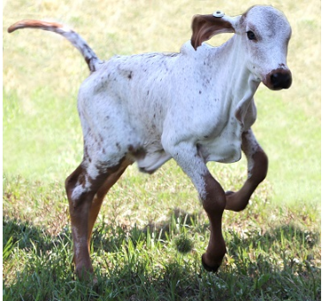

USDA Agricultural Research Service
ARS Update
National Agricultural Research, Extension, Education, and Economics Board
6 June 2023
Mr. Joon Park
Acting Associate Administrator, Research Operations & Management
ARS scientists and collaborators produced the first gene-edited calf with resistance to bovine viral diarrhea virus, which costs the U.S. cattle sector billions of dollars annually.
Agricultural Research Service
U.S. Department of Agriculture

Slide 3
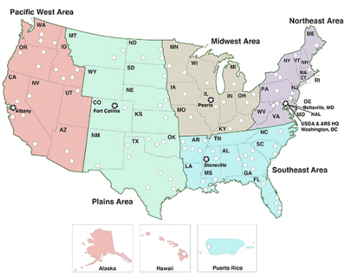
ARS By the Numbers
600+ Research projects
2,000+ Scientists and post docs
90+ Research locations
FY 2023 Budget
  $1.74B Salaries & Expenses (S&E)
    $111M increase in FY 2023
  $132.3M Buildings & Facilities (B&F)
FY 2024 Proposed PRESBUD
  $1.938B for S&E
  $41.4M for B&F
  House Ag Appropriations SubCmte
    Passed FY 2024 Ag Bill at $1.745B ($1.2M Increase)
    $16.7M for B&F
    Still pending Full Appropriations Cmte and House approval
Agricultural Research Service
U.S. Department of Agriculture

Slide 4
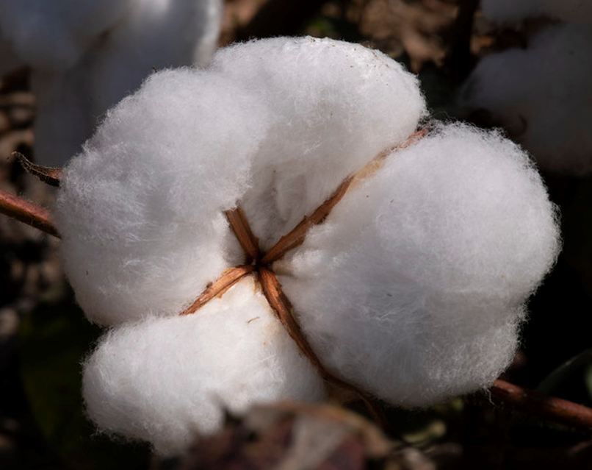
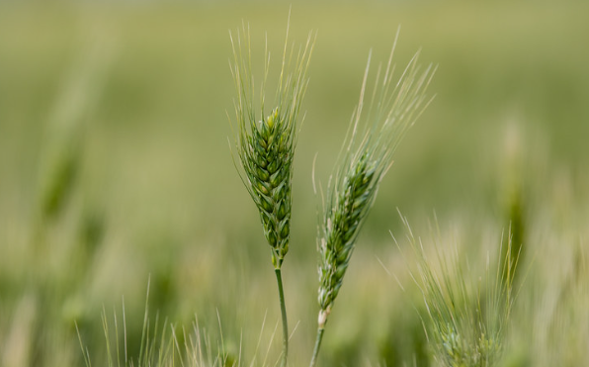
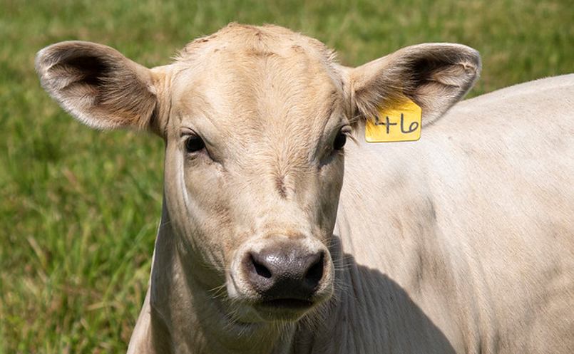
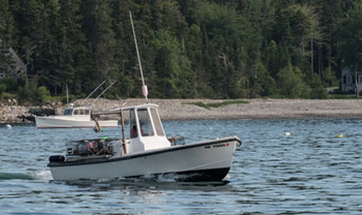
Budget & Funding Allocation
Agricultural Research Service
U.S. Department of Agriculture

Slide 5
B&F Funding since 2015 ($1.36B)
ARS Capital Investment Strategy (CIS)
Co-Located list with Universities
Community Based Projects at ARS Locations (CBP)
MAJOR B&F PROJECT STATUS, JUNE 2023
Area | Location | Status | Construction completed (estimate)
NEA | Fort Detrick, MD | in planning | December 2026
NEA | University Park, PA | in construction | April 2025
NEA | Geneva, NY | in design | December 2026
NEA | Beltsville, MD (B002) | in construction | March 2025
NEA | Beltsville, MD (B005) | in procurement | January 2026
NEA | Beltsville, MD (B308) | in design/awating funds | TBD
MWA | Madison, WI | in design | December 2026
MWA | Columbia, MO | in construction | October 2024
MWA | Lexington, KY | in design | November 2026
SEA | Athens, GA | in construction | December 2024
SEA | Tifton, GA | in design | November 2025
SEA | Auburn, AL | in design | February 2026
SEA | Raleigh, NC | in design | December 2025
PA | Houston, TX | in construction | June 2025
PA | Kerrville, TX | in construction | March 2025
PA | Lincoln, NE | in design | TBD
PWA | Tucson, AZ | in construction | December 2023
PWA | Salinas, CA | in construction | July 2024
PWA | Pullman, WA | in procurement | February 2026
PWA | Davis, CA | in design | September 2026
PWA | Corvallis, OR | in construction | October 2024
23 CIS Projects Fully Funded
4 CIS Projects Funded for Design Only
24 different Locations with approximately 40 different CBPs
Agricultural Research Service
U.S. Department of Agriculture

Slide 6
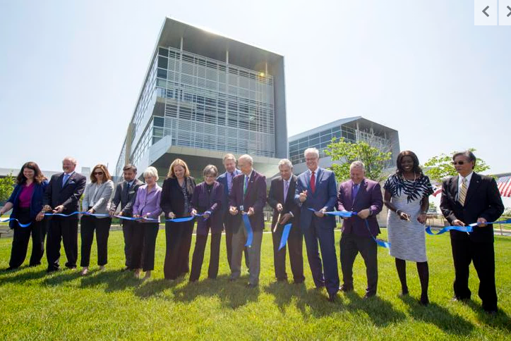
National Bio & Agro Defense Facility (NBAF)
NBAF ribbon cutting 24 May 2023
Contractor commissioning DEC 2022
Pending formal ownership of the facility from DHS to USDA
Pending full transition of ARS and APHIS research operations from Plum Island
Agricultural Research Service
U.S. Department of Agriculture

Slide 7
Climate
May 2023: USDA Science & Research Strategy 2023-2026
  Prioritizes climate smart research & production
  Climate research remains a significant focus across ARS
  5 focus areas
    Climate change impacts
    Climate change mitigation
    Adaptation to a changing climate
    Decision support tools
    Bioeconomy
Agricultural Research Service
U.S. Department of Agriculture

Slide 8
Climate
Climate Hubs
  FY 2022 Climate Hub Fellows Initiative
  Greater emphasis on knowledge and service delivery
    Hawaii / Affiliated Pacific Islands
    Alaska
  Science coordinator as each Hub for greater collaboration
  Northwest Climate Hub: Future Crop Suitability Tool
  Caribbean Climate Hub: Caribbean Drought Learning Network
  Northeast Climate Hub: Installation of weather stations on Tribal lands
  Establishment of an International Climate Hub
Agricultural Research Service
U.S. Department of Agriculture

Slide 9
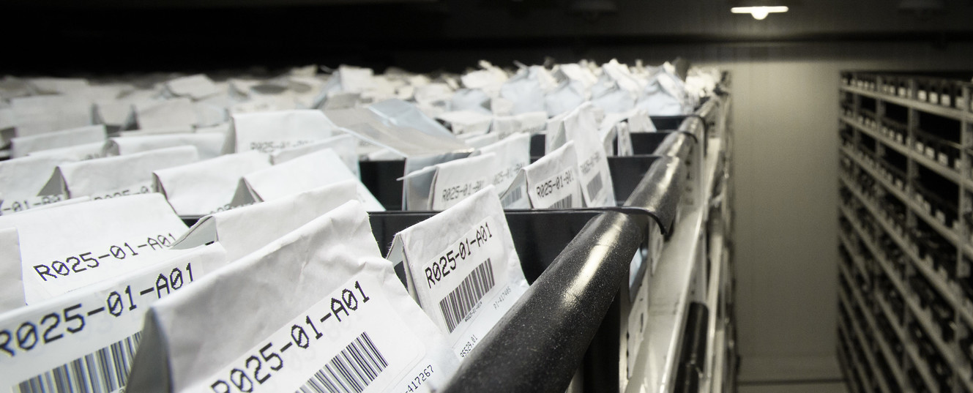
USDA ARS National Plant Germplasm System
22 Genebanks
  Manage 200+ crops
  Maintain 600,000+ kinds of plant germplasm
  Distribute 200,000+ research samples annually
Challenges
  Backlog in
    Securing plant germplasm in long-term storage
    Testing plant germplasm quality & health
    Regenerating plant germplasm
    Characterization, trait evaluations & genetic enhancement of germplasm
ARS National Plant Germplasm System cold storage vault in Fort Collins, Colorado
Agricultural Research Service
U.S. Department of Agriculture

Slide 10
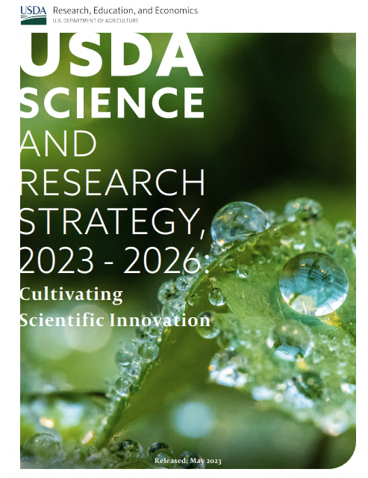
Nutrition Security & Health
May 2023: USDA Science & Research Strategy 2023-2026
  5 focus areas
    Inclusive Food Systems
    Data Transparency
    Predictive Analytics
    Pathogen Virulence Factors
    Food Systems Understanding and Impact
Agricultural Research Service
U.S. Department of Agriculture

Slide 11
Nutrition Security & Health
Precision Nutrition
  Identifying how food, food components and physical activity help prevent diet related chronic diseases
  Contributing to the Biden Administration’s Cancer Moonshot
  ARS & Texas A&M collaboration
    Co-location of ARS Responsive Agricultural Food Systems Research Unit at TAMU
    Nutrition and human health to include disease prevention
ASCEND Community Engagement & Listening Sessions
  Build trust
  Ensure those with lived experience have a voice
  Connect nutrition related research to specific populations
    JAN 2023 Baton Rouge, LA with Southern University
    MAR 2023 Laredo, TX with Texas A&M
    MAY 2023 Bismarck, ND with United Tribes Technical College
Agricultural Research Service
U.S. Department of Agriculture

Slide 12
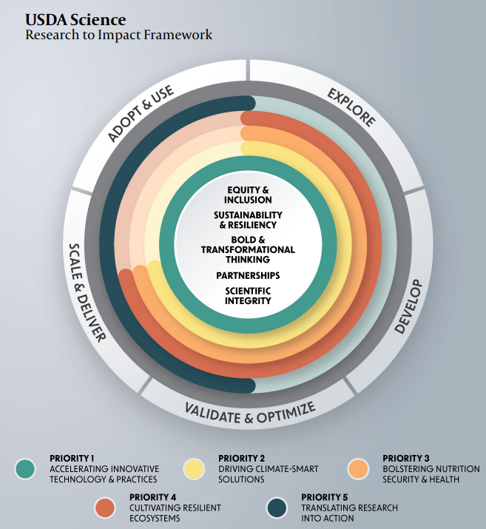
Thank You!
Agricultural Research Service
U.S. Department of Agriculture

