Slide 1
For assistance in accessing this document, please contact nareee@usda.gov.

Slide 2

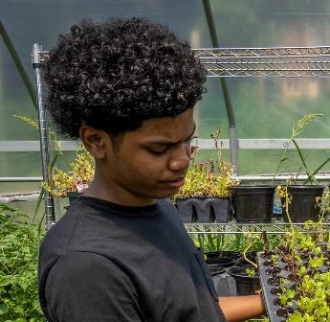
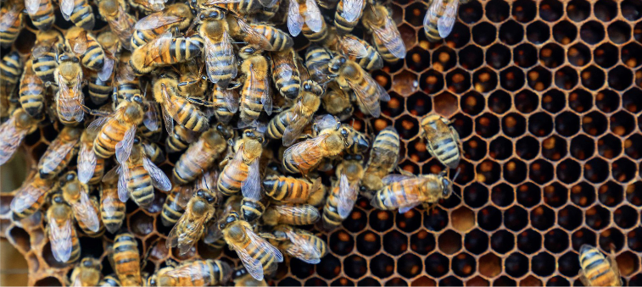
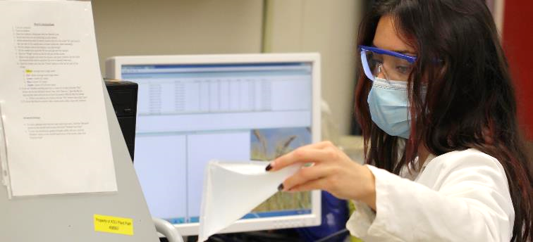




REE and USDA Science Updates
Prepared for National Agricultural Research, Extension, Education, Economics, and Advisory Board
June 6, 2023
Dr. Chavonda Jacobs-Young
Under Secretary for Research, Education, and Economics and
USDA Chief Scientist

Slide 3
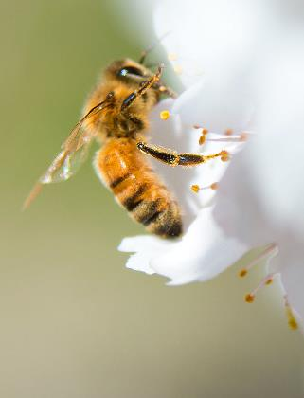

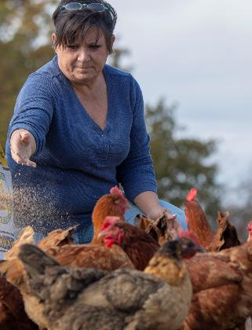


MISSION OF REE
REE is dedicated to creating a safe, sustainable, competitive, and equitable U.S. food and fiber system.
We support American farmers, ranchers, and foresters and help build stronger communities, families,
and youth through sound integrated research, analysis, and education.
Agricultural
Research
Service
Economic
Research
Service
National
Agricultural
Statistics
Service
National
Institute of
Food and
Agriculture
Office of the
Chief Scientist

Slide 4
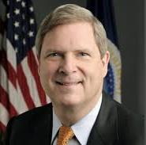
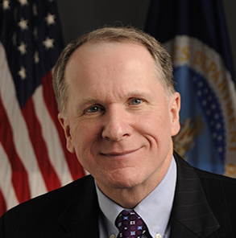
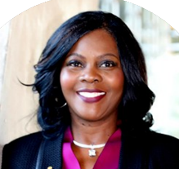
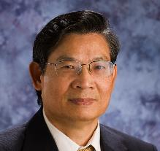

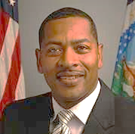
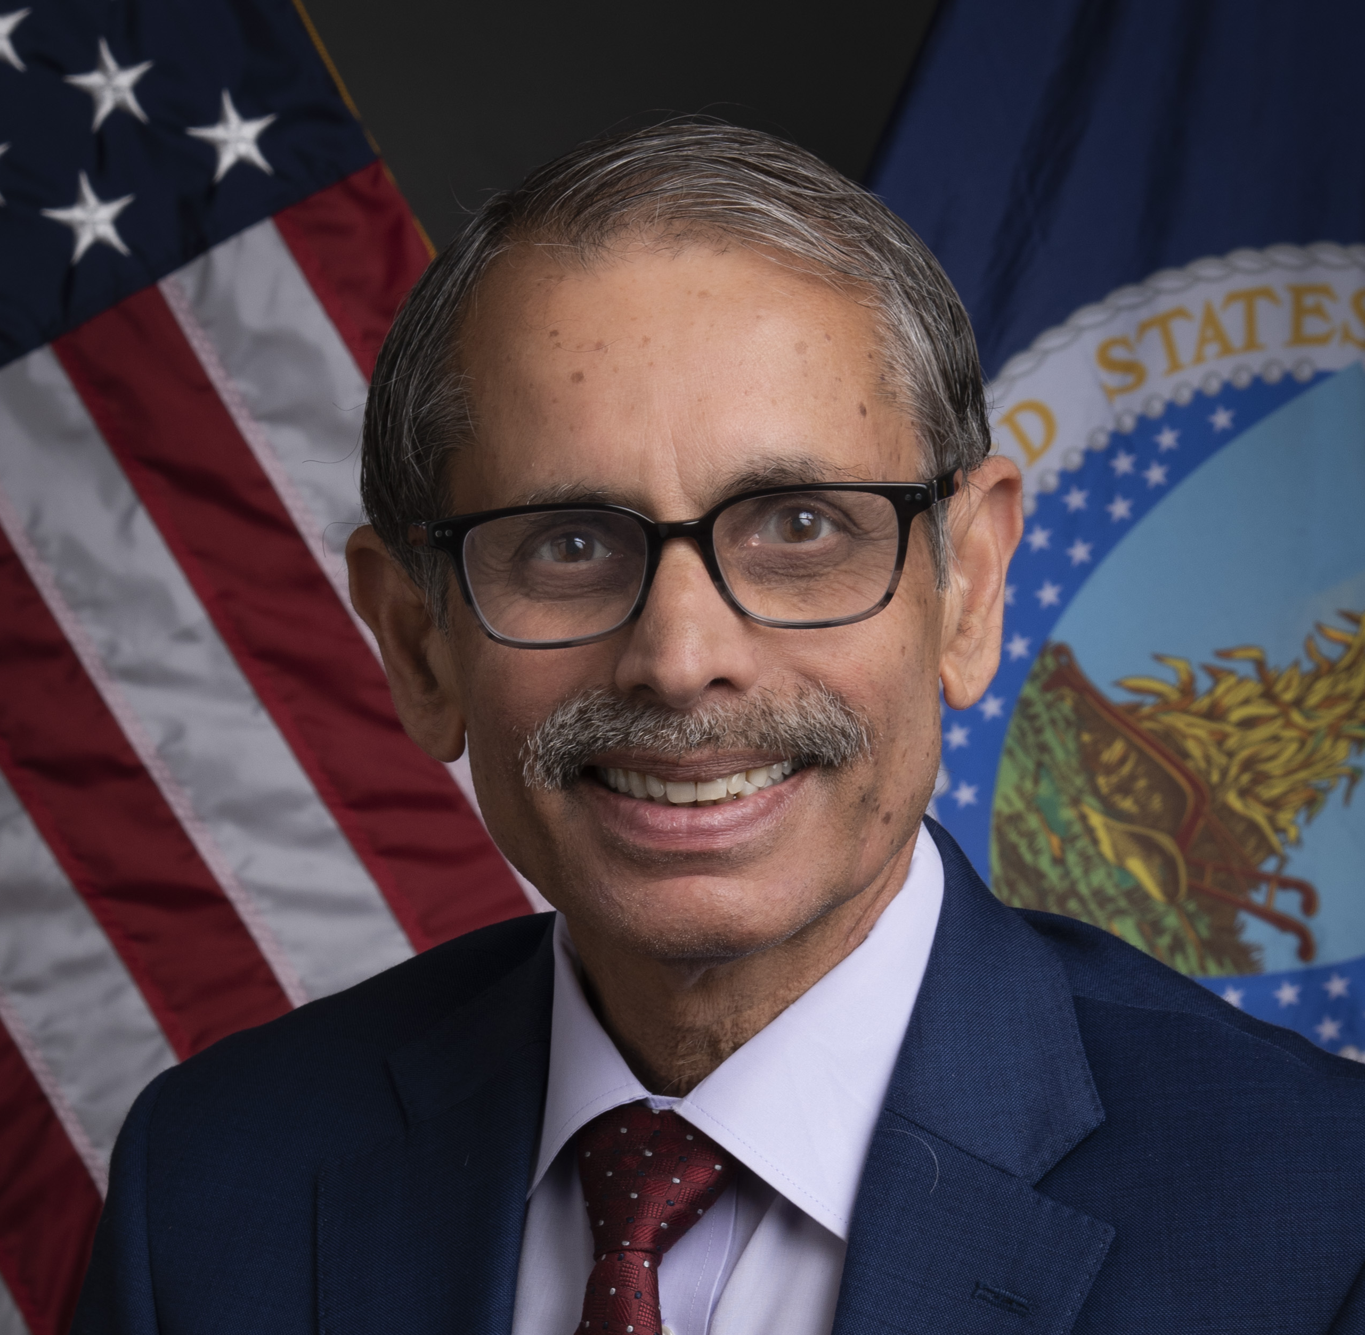
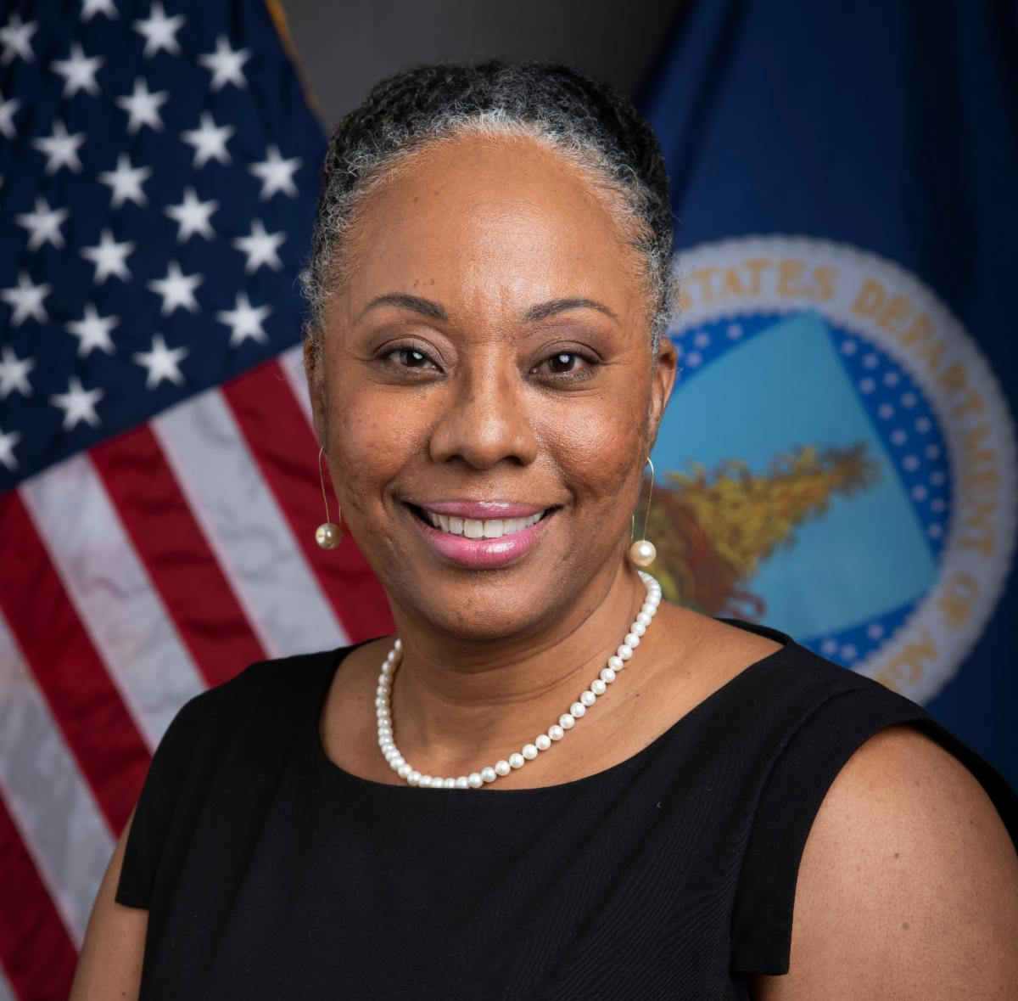
REE LEADERSHIP
USDA LEADERSHIP
  Tom Vilsack
  Secretary of Agriculture
  Kevin Shea
  Acting Deputy Secretary of Agriculture
Chavonda Jacobs-Young
Under Secretary
Research, Education, and Economics & USDA Chief Scientist
Simon Liu
Administrator
Agricultural Research Service
Spiro Stefanou
Administrator
Economic Research Service
Hubert Hamer
Administrator
National Agricultural Statistics Service
Manjit Misra
Director
National Institute of Food and Agriculture
Deirdra Chester
Director
Office of the Chief Scientist
4

Slide 5
REE Funding
5

Slide 6

USDA IS BUILDING U.S. AGRICULTURE BACK BETTER
6
Notes:
REE’s focus continues to build and strengthen our research capacity to help achieve the Administration’s and the Secretary’s priorities for USDA:
addressing climate change through smart agriculture and forestry
advancing justice, equity, and inclusion within the agriculture world
creating more and better markets
enhancing food nutrition and reducing food insecurity, and
making the USDA an even better place to work by supporting workforce development and encouraging the next generation of workers and diversifying our workforce.
[NEXT SLIDE]
The work we do in REE is an integral part of these priorities and scientific research intersects all of them!

Slide 7


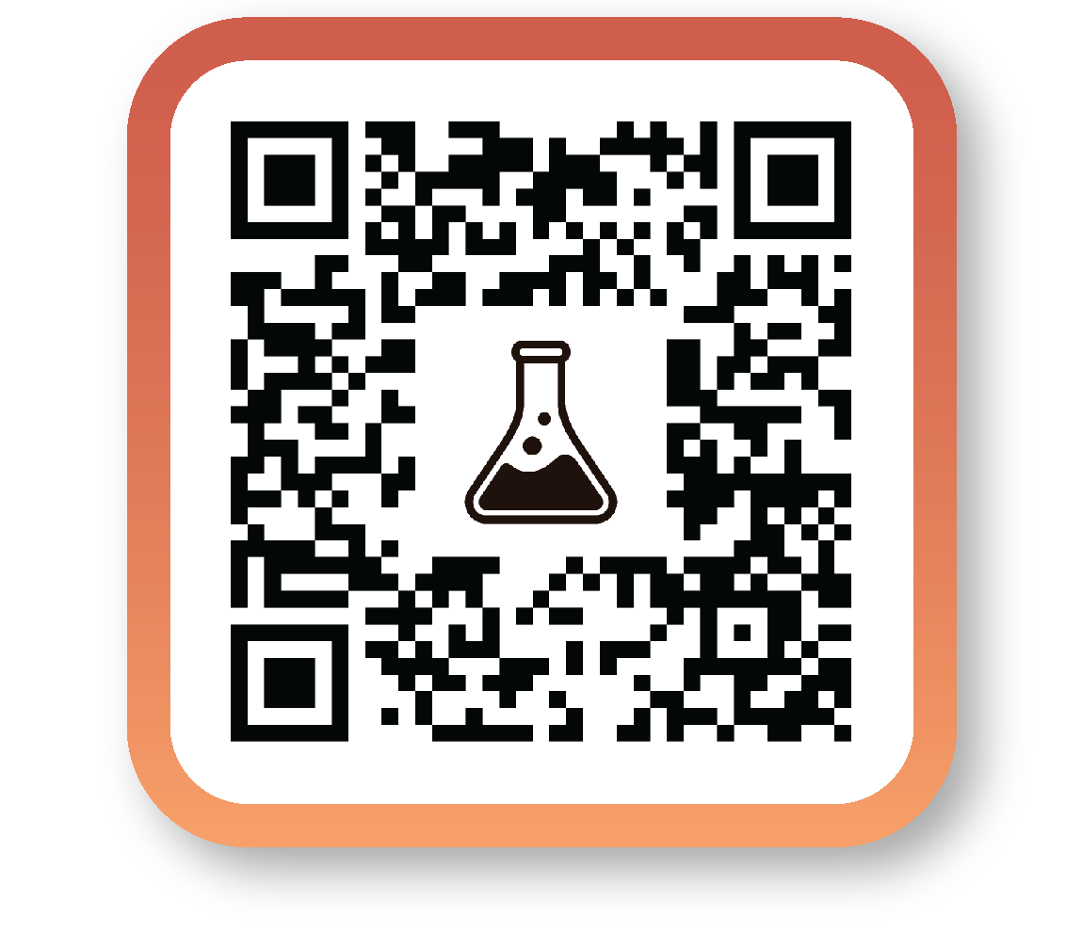

Slide 8
USDA’S FIVE SCIENCE PRIORITIES

Slide 9
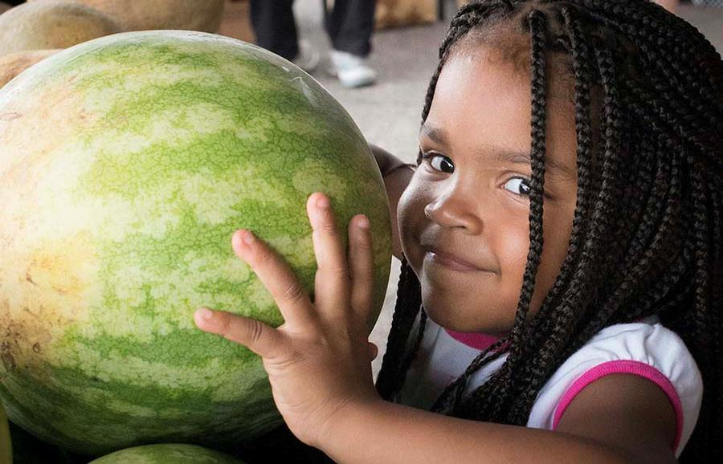
Precision
Nutrition

Slide 10

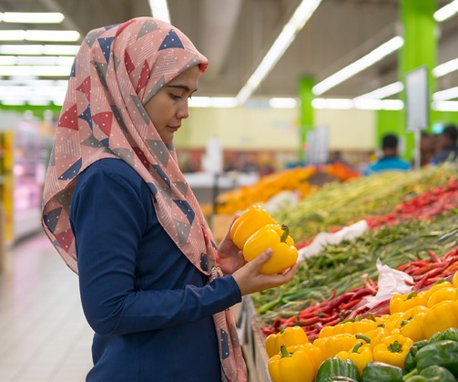
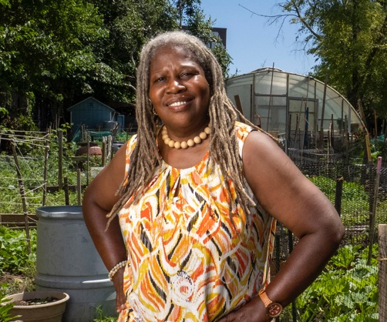
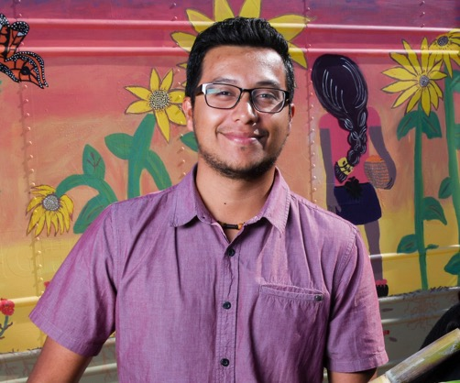
USDA Nutrition Assistance Programs
1 in 4 Americans is served by one of USDA’s 15 nutrition assistance programs
3

Slide 11
The challenge of diet-related chronic diseases
The U.S. faces an urgent, nutrition-related health crisis—the rising prevalence of diet-related diseases such as type 2 diabetes, obesity, hypertension, and certain cancers.
The consequences of food insecurity and diet-related diseases are significant, far reaching, and disproportionately impact historically underserved communities.
Yet, food insecurity and diet-related diseases are largely preventable, if we prioritize the health of the nation.

Slide 12
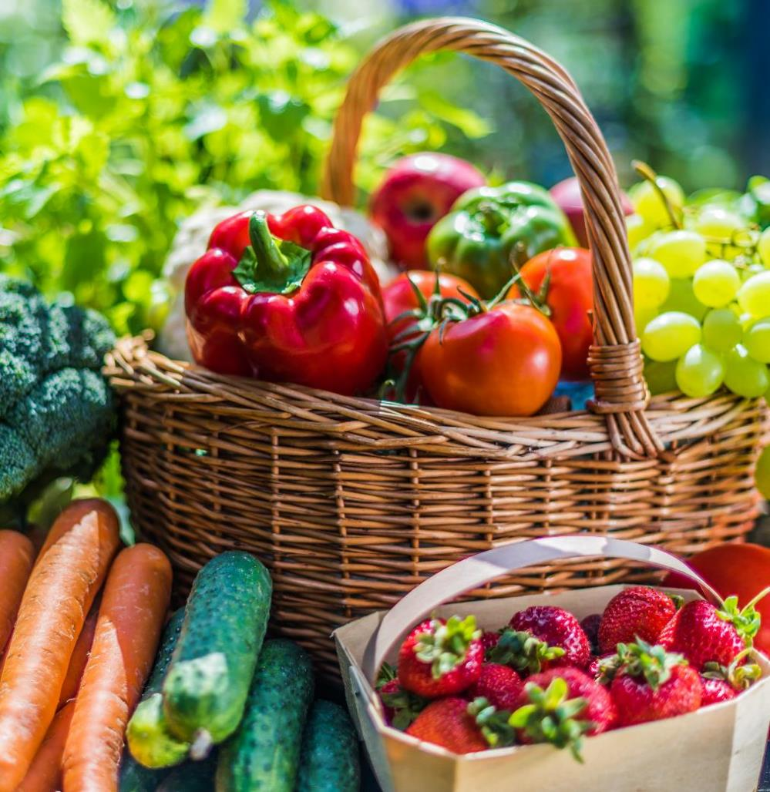
TACKLING FOOD AND NUTRITION INSECURITY
White House Conference on Hunger, Nutrition, and Health last September.
Goal: end hunger and increase healthy eating and physical activity by 2030.
A national, federal strategy was announced at the Conference.
REE agencies play a key role in providing scientific research and data that underpin nutrition guidelines and programs for the U.S., including in underserved communities.
12

Slide 13
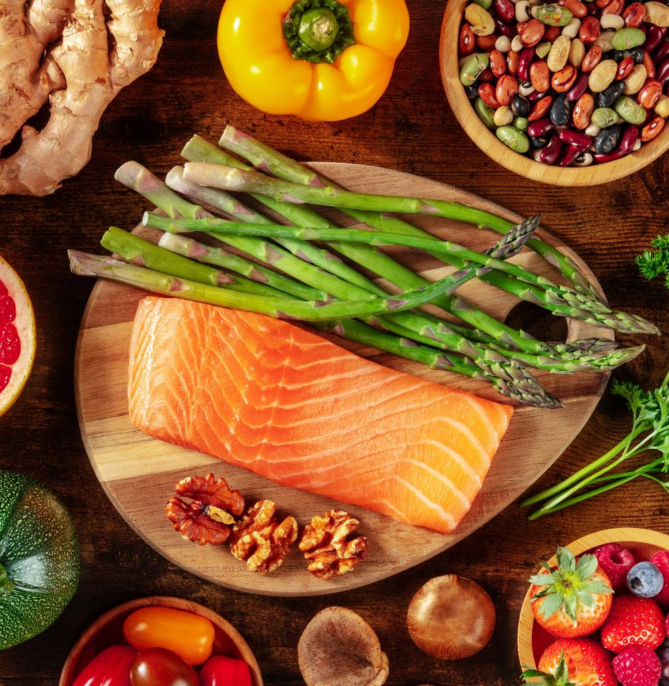
PRECISION NUTRITION - CANCER MOONSHOT
Goal: reduce cancer death rate by at least 50% over the next 25 years and improve the experience of people and their families living with as well as surviving cancer.
USDA Science can help prevent cancer, while others work to cure cancer.
REE is uniquely positioned for a systems-based approach for integrating research and program activities across REE and USDA.
Visit USDA’s Cancer Moonshot website for more information: https://www.ree.usda.gov/topics/cancer-moonshot
13

Slide 14
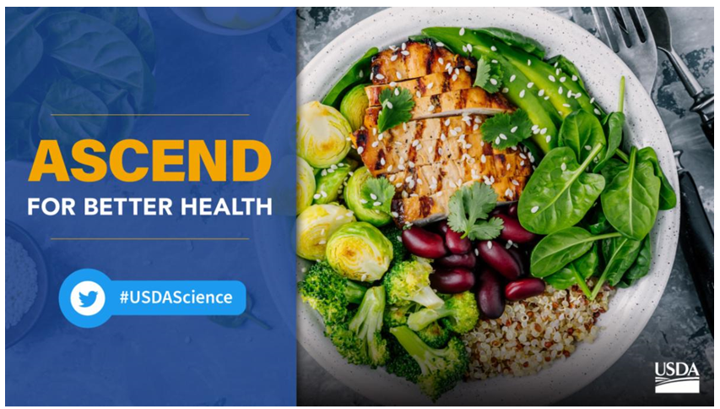



A new USDA initiative to address diet-related chronic diseases
Research
Data
Engagement
14

Slide 15
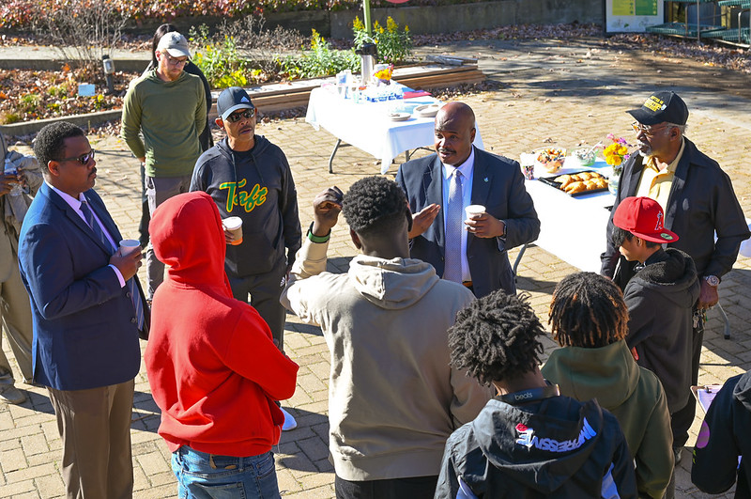
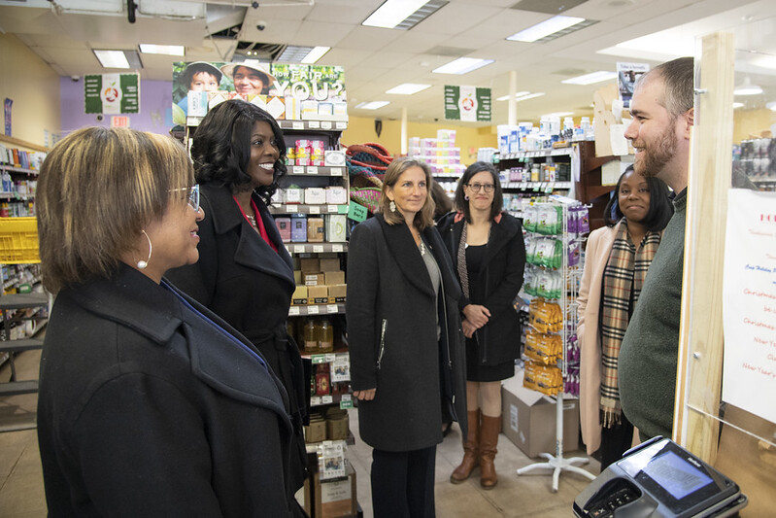
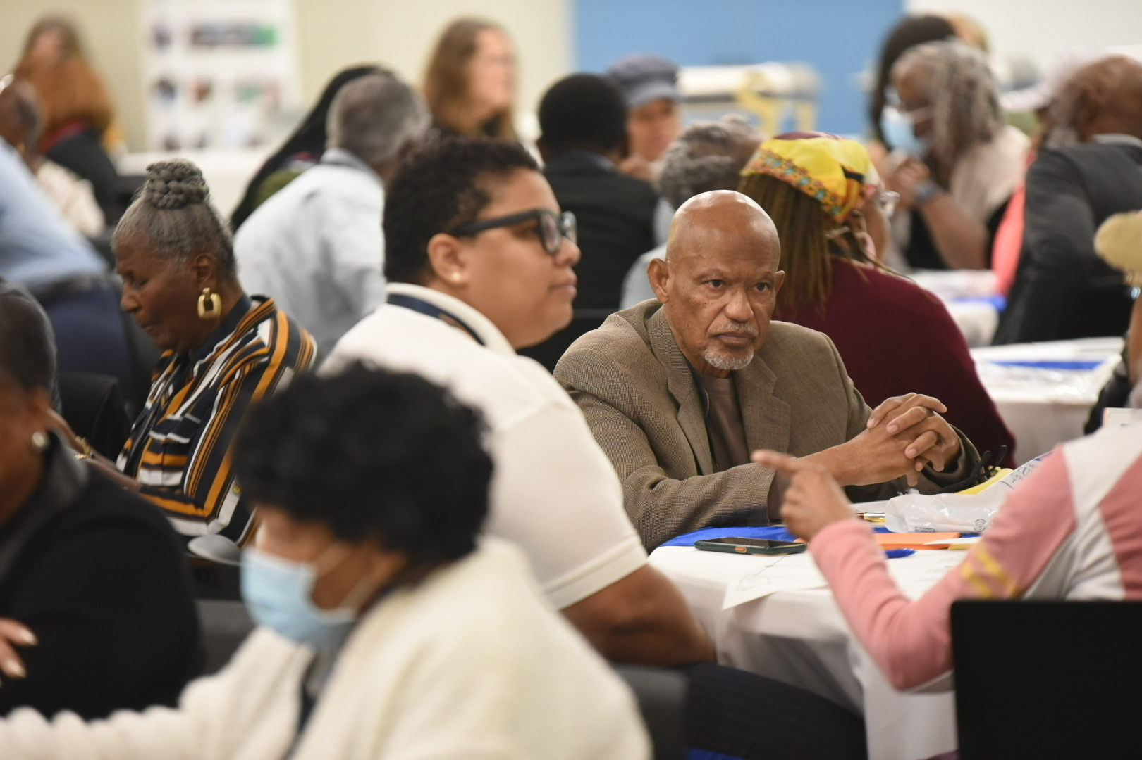
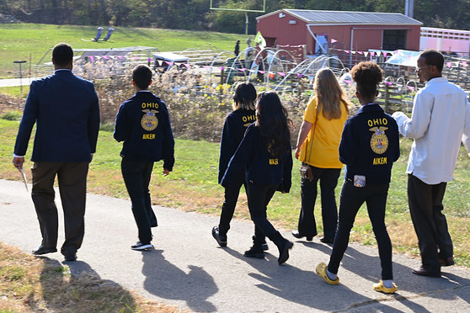
Community Engagement
Goals:
Have open and honest conversation about the challenges and opportunities we have with food and nutrition.
Establish a shared goal of improving health through food and nutrition.
Build trust and establish two-way communication.
15

Slide 16



HISTORIC LANDMARK INVESTMENTS
American Rescue Plan
Bipartisan
Infrastructure Law
Inflation
Reduction Act

Slide 17
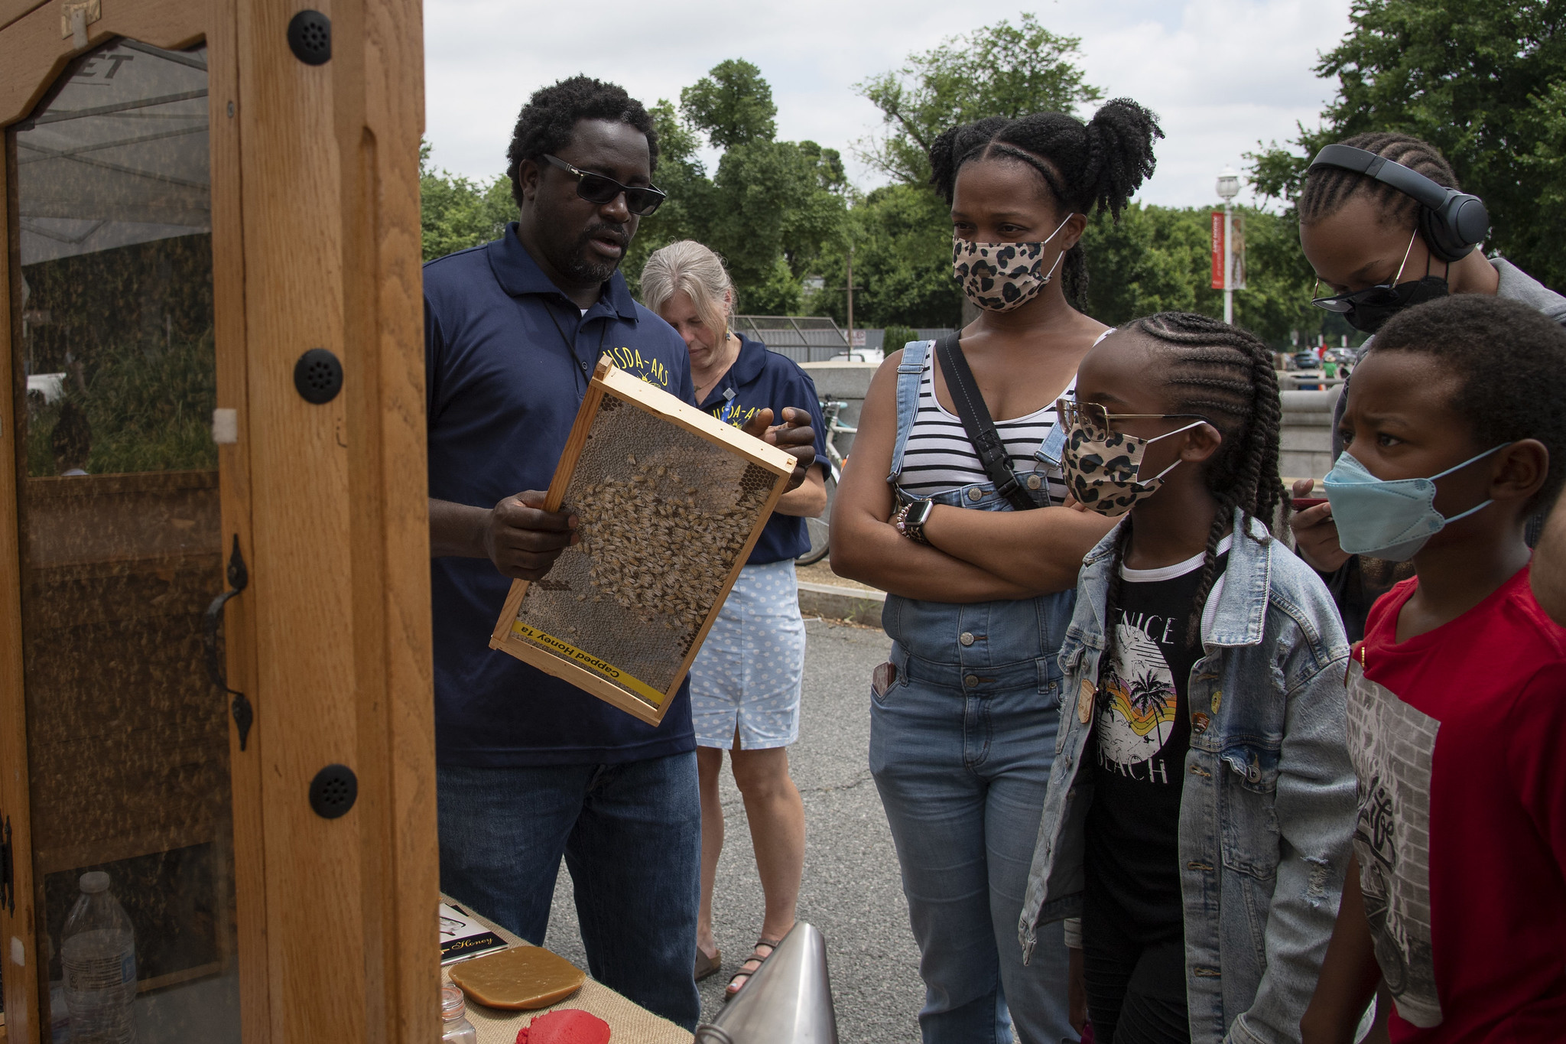
Next Generation of Agriculture Leaders

Slide 18
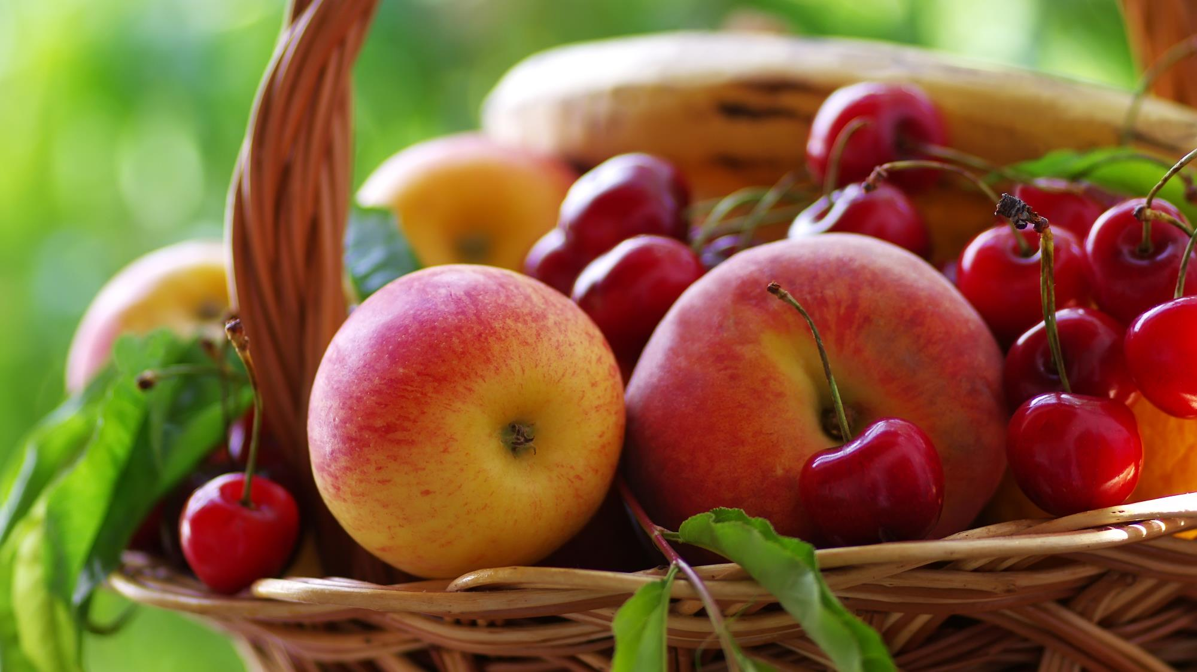

THANK YOU!
Chavonda Jacobs-Young
Email: c.jacobsyoung@usda.gov
Follow us on Twitter
@USDAScience

