Slide 1
For assistance in accessing this document, please contact nareee@usda.gov.

Slide 2
The Role of Diversity, Equity, Inclusion and Accessibility at USDA
NAREEE Board Meeting on Diversity and Inclusion
L’Tonya Davis
Chief Diversity and Inclusion Officer
June 7, 2023

Slide 3
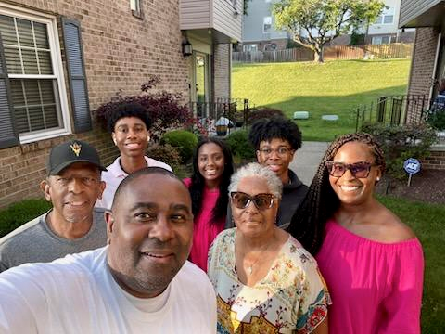
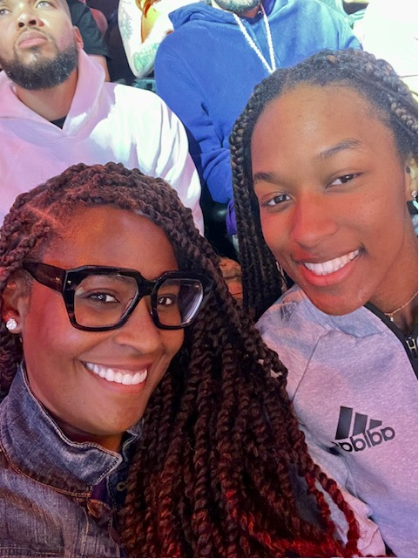
About Me
Notes:
Intro
Master of Public Management and a Bachelor of Communications from the University of Maryland, College Park. She completed the University of South Florida’s Diversity, Equity and Inclusion certificate program, the Strategic Diversity and Inclusion Management program at Georgetown University as well as the New Inclusion Quotient, an Office of Personnel Management (OPM) diversity and inclusion program. She also completed the Leadership for a Democratic Society program at OPM’s Federal Executive Institute.

Slide 4
Federal Government DEIA Efforts
DEIA is a key priority of the Biden-Harris administration agenda.
There are several Executive Orders related to DEIA helping drive concrete actions across Government.
EO 13985, Advancing Racial Equity through the Federal Government is the governing document for our external/programmatic equity work.
EO 14035, Diversity, Equity, Inclusion, and Access in the Federal Workforce is the governing document for our internal DEIA equity work.
EO 13988, Preventing and Combating Discrimination on the Basis of Gender Identity or Sexual Orientation
. The Justice40 initiative, EO 13175 Tribal Consultation, and EO 14058 Customer Experience.

Slide 5
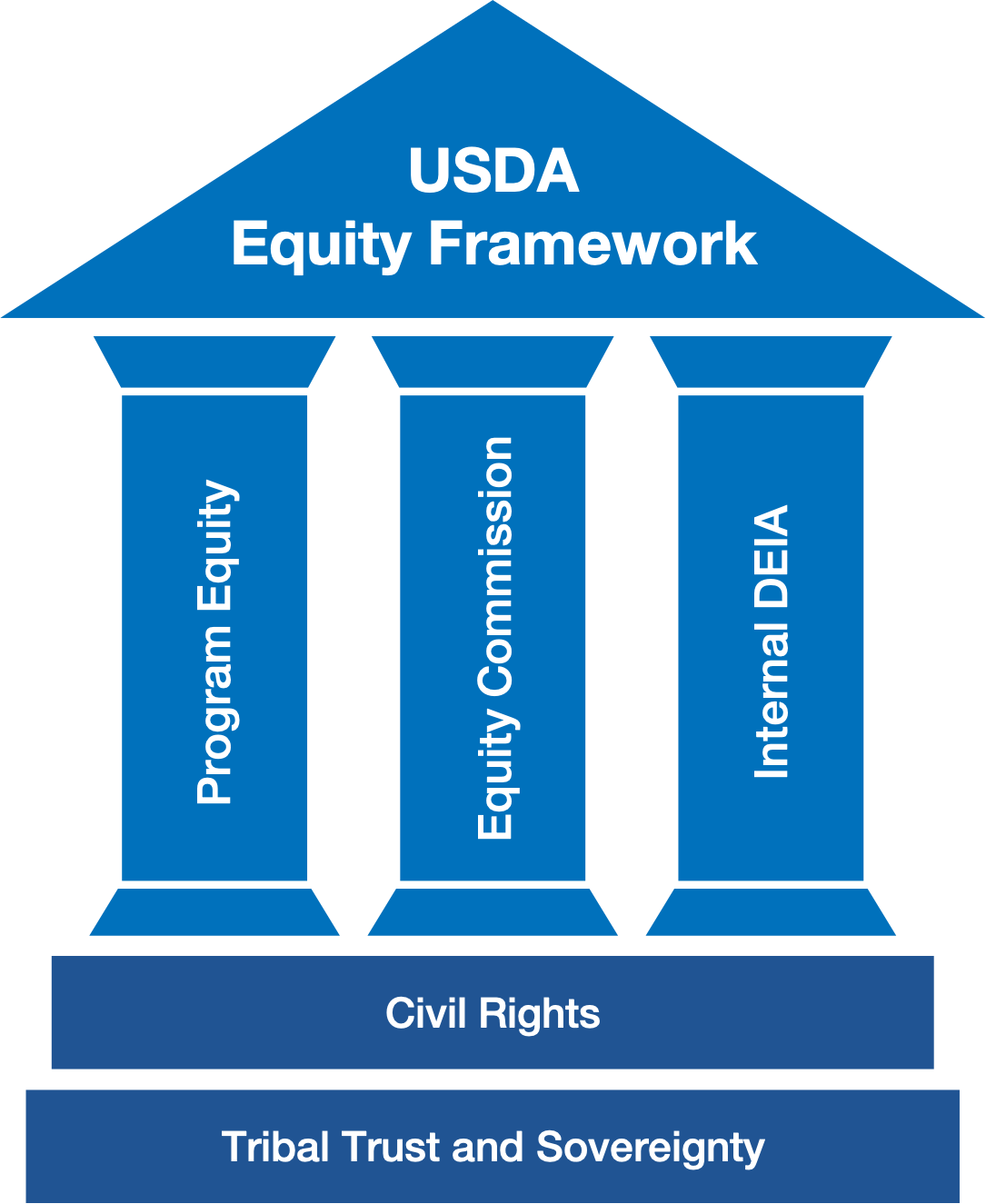
USDA Equity Framework: The Pillars
Notes:
USDA is advancing racial justice and equity with a three-pronged approach: the work focuses on Program Equity, the Equity Commission, and Internal DEIA, all building on our obligation to upholding civil rights and our trust and treaty responsibilities with Indian tribes. The picture of our equity framework represents our approach:
Program Equity
Identify and root out systemic discrimination in USDA programs.
Ensure equitable access to USDA programs and services for all parts of the community, including removing uneven barriers to access and working to repair past mistakes that have resulted in economic, social, and racial disparities.
Contribute to lessening broader inequities in American life.
Equity Commission
To provide recommendations to the Secretary on policies, programs, and actions needed to address racial equity issues within the Department of Agriculture and its programs, including strengthening accountability at USDA and to provide recommendations to the Secretary on broader and more systemic equity issues at USDA.
Internal DEIA
to improve DEIA across the Department and will oversee the implementation of USDA’s first-ever DEIA Strategic Plan in a coordinated effort with the Office of Human Resources Management (OHRM) and the Office of the Assistant Secretary for Civil Right (OASCR).

Slide 6
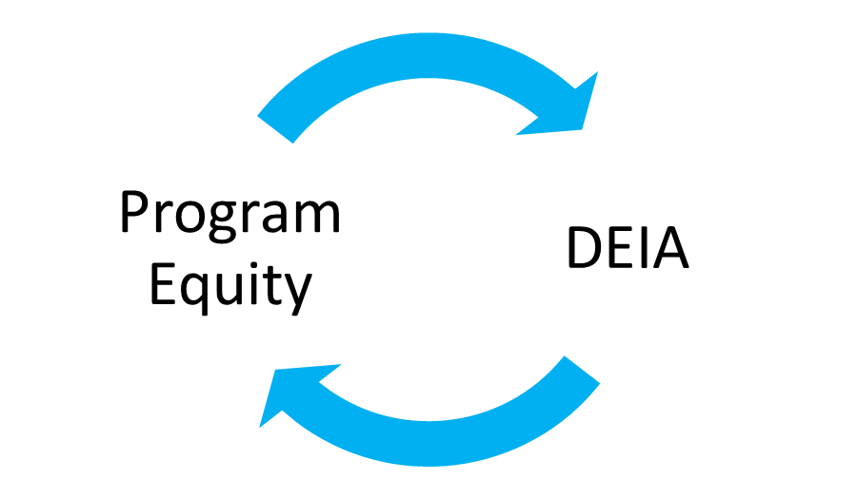
Program Equity Interaction with DEIA
Diverse workforce helps improve equitable access to programs
Department's equity commitments to avoid and repair discrimination, and to lower barriers to access, helps recruit diverse workforce.
But policy levers, skill sets, and organizational structures are different.

Slide 7
Internal DEIA Overview
USDA is expanding investments to improve its DEIA leadership and management for an internal workforce where all employees are treated with dignity and respect and thrive in their contributions to USDA’s mission.
Cultivating a workforce that draws from the full diversity of the nation.
Strengthening our ability to recruit, hire, develop, promote, and retain our nation’s talent;
Remove barriers to equal opportunity; and
Foster a culture of leaders and employees who excellence as an inclusive, innovative, and high performing workforce.

Slide 8
USDA DEIA Strategic Plan Approach
At the core of USDA’s DEIA Strategic Plan are six goals that will be the foundation for our activities for the next five years.
Build
Build a culture that drives trust, belonging, transparency, accountability, and employee empathy.
Achieve
Achieve a workforce representative of Americans that inspires development of innovative ideas and best practices.
Foster
Foster a workplace environment that is physically, mentally, and emotionally safe.
Establish
Establish leadership and governance structures to support long-term and sustainable DEIA efforts.
Promote
Promote empowerment, responsibility, and accountability for DEIA through developing the workforce.
Demonstrate
Demonstrate a commitment to a diverse, equitable, inclusive, and accessible USDA through accountability, data collection, analysis, and effective policymaking.

Slide 9
FY 23 – 24 Next Steps for CDIO Office
Establishing
Collaborating
Collaborating with OASCR and OHRM to advance DEIA efforts across USDA –wide.
Developing
Developing a USDA-wide communication and engagement strategy that grows awareness, empowers employees, and positively influences a culture of inclusion for all employees.
Establishing the initial structure for the new Chief Diversity and Inclusion Office within the Department
Identifying
Identifying a governance structure for guiding and delivering high-performance for DEIA through strong and committed USDA-Wide leadership engagement.

Slide 10
Institutionalizing Systems and Structures
Organizational Structure and Governance: Finalize the governance structure, staffing and funding for CDIO Office in the Office of the Secretary at USDA.
Develop Mission Area/Agency Capacity: Develop recommendations and guidelines for staffing, structure, investments and funding for mission areas/agencies. Coordinate with mission areas to adapt based on current DEIA organizational capacity
Focus on Data-driven DEIA Accountability: Develop 2023 Action Plan for USDA “Workforce Vital Signs Dashboard for All Agencies
Data-Driven Measurement Tools: Use “Vital Signs” data (some or all) to establish QSR metrics for first-year evaluation in partnership with OHRM and OASCR and SES Performance Supplemental Standards for DEIA Outcomes
Focus on Integration and Elevation for Impact: Conduct department-wide round-up on status of other OPM-directed DEIA goals for disability hires (especially DHH support), Reasonable accommodations, SES representation, Student Internships, Coaching/Mentoring/Career Development, DEIA Training and current work environment and related performance measures
Notes:
Institutionalizing DEIA Systems, Structures, Policies across USDA
Departmentwide Shared Leadership, Unit-Level DEIA Plans, Investing in Organizational Capacity to lead and deliver DEIA priorities. Shared leadership among CDIO/OASCR/OHRM
Developing Common Data-Driven Framework for DEIA outcomes (measures, best practices for using data and information to drive results)
Implement Anti-Harassment Policy and Program (Led by OHRM)

Slide 11
Activating Communication, Engagement and Learning
Preparing Leaders to Lead: Invest in preparing leaders to lead in the DEIA sphere enhancing connection, competency and commitment to DEIA objectives and outcomes.
Awareness and Engagement: Develop events, activities, and project management plan for implementing Communication and Engagement strategy. Integrate with Adaptive Leaning and Training outcomes actions for “DEIA and USDA Infomercial” Core Values Engagement and “New Conversations”
Employee-Centered Implementation: Focus on Employee Resource Group (ERG) Collaboration-Develop an ERG Partnership and Empowerment plan
Promoting Inclusive Hiring: Develop and implement tools and resources for promoting inclusive hiring targeted to middle managers/leaders. Finalize policy direction in collaboration with OHRM. deliver learning modules and develop tool to track utilization.
Learning and Aligning Together: Develop an Adaptive Learning and Training Action (ALTA) Plan for all levels of employees with recommended trainings and dialogues prioritizing employee engagement and experiential learning through DEIA topics – integrate with Communication and Engagement Strategy
Notes:
Activating DEIA Communication, Employee Learning and Engagement
Preparing Leaders to Lead DEIA Priorities through upcoming engagements with Mission Area, Agency and Staff Office Leadership Teams
Engaging and developing employee’s skills through a new DEIA Adaptive Learning and Training Action Plan
Renewed focus to Promote Inclusive Hiring/Minimize Bias in Hiring
Formalizing Program to empower Employee Resource Groups to Impact DEIA Success
Launching “Advancing DEIA at USDA” Video to demonstrate the united commitment between CDIO, OASCR, and OHMR to advance DEIA at USDA

Slide 12
LTonya.Davis@usda.gov
Questions
Thank you!

