Slide 1
For assistance in accessing this document, please contact nareee@usda.gov.

Slide 2
Economic Research Service at a Glance
Dr. Spiro Stefanou
USDA Economic Research Service Administrator
NAREEE Advisory Board Meeting
June 6, 2023

Slide 3
Our Mission
To anticipate trends and emerging issues in agriculture, food, the environment, and rural America and conduct high-quality, objective economic research to inform and enhance public and private decision making.

Slide 4
As one of 13 principal federal statistical agencies, ERS is responsible for ensuring the quality, objectivity, and transparency of the statistical information we provide.

Slide 5
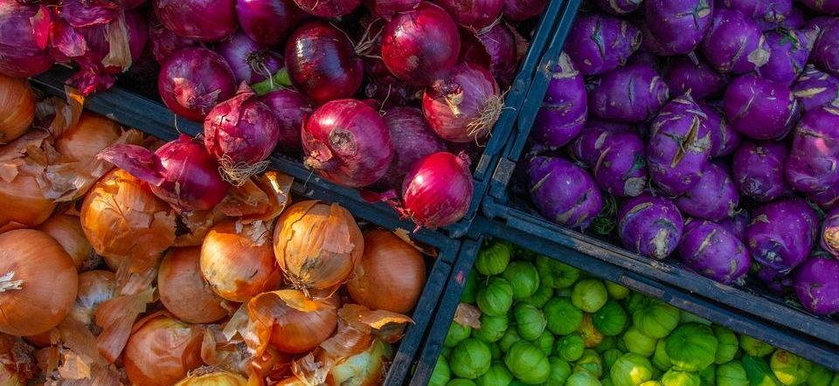
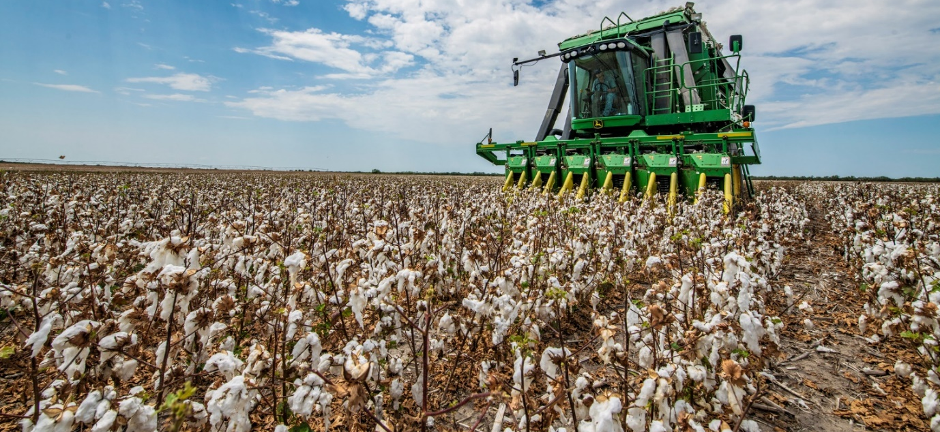
ERS Research Addresses Several Key Issues
Farm Income, Labor & Policy
Financial Risk & Tax Policy
Rural Infrastructure
Trade Policy/Foreign Competition
Technology Adoption & Precision Ag
Rural Economic Prosperity
Healthy, Local, Organic Foods
Income & Debt
Water Use, Irrigation, & Resource Conservation
Consumers & Food Assistance Policy
Beginning Farmers
Food Safety Rules
Risk Management
Bioenergy
Land Use

Slide 6
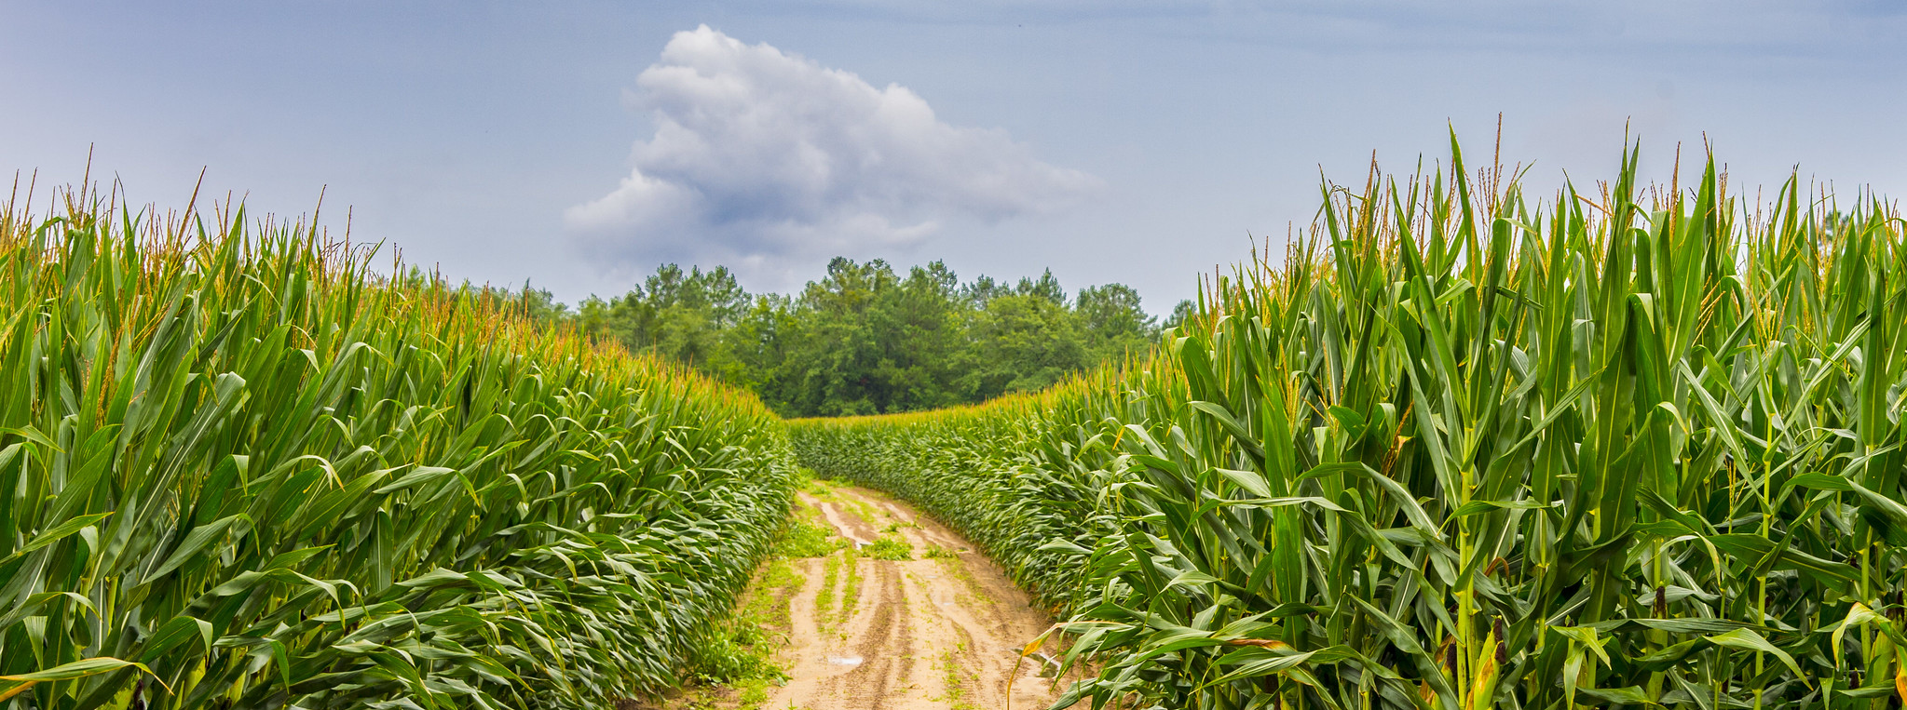
The Path Ahead
A Focus on Interconnected Research

Slide 7
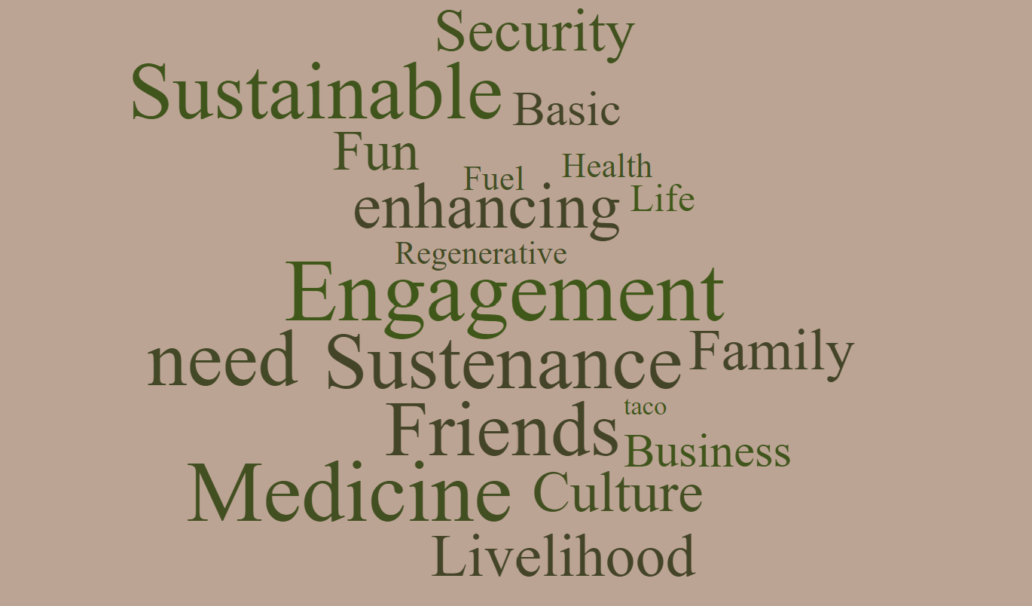
Food is ______ ?

Slide 8
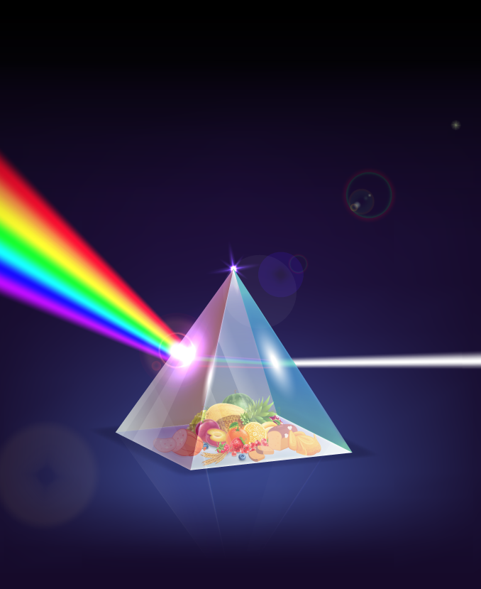
Food Chain
Inputs / Production / Processing / Access
Health Factors
Food Quality & Safety / Access to Healthy Foods
Ecological Landscape
Societal Influences
Sustainability / Adaption/ Mitigation / Conservation
Food Security / Equity / Rural Prosperity
The Food Environment:
A Prism of Interdependent Systems
ERS Research
Food
Environment

Slide 9
Current Priorities
Deliver Timely Research on Emerging Issues
Expand Data Accessibility
Pursue DEIA Research & Innovation

Slide 10
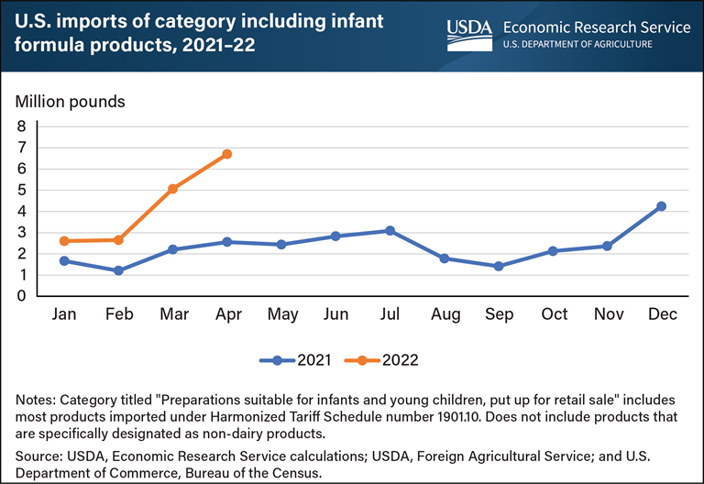
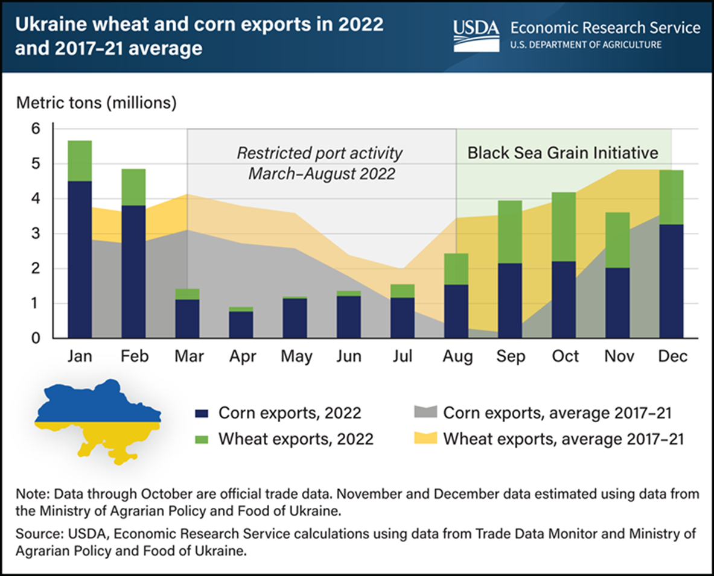
Delivering Timely Research on Emerging Issues
Timely research on emerging issues:
COVID-19 Pandemic
Agricultural Markets in Russia & Ukraine
Infant Formula Shortage
International Food Security Assessment

Slide 11
Expanding Data Accessibility
Data Training Webinars
Webinar series on ERS data products & how to use them
Food Price Outlook
Farm Income & Wealth Statistics
U.S. & International Agricultural Productivity
Price Spreads from Farm to Consumer
Food Access Research Atlas & Food Environment Atlas
Many others & more to come in 2023!
Standard Application Process for Accessing Restricted Data
Joint effort with the Interagency Council on Statistical Policy to build a standard application process & portal for requesting use of restricted-access data
Partnership with the Robert Wood Johnson Foundation
$1.4 million in research grants aimed at improving equitable healthy food access using USDA’s Consumer Food Data System
www.ers.usda.gov/data-training-webinars

Slide 12
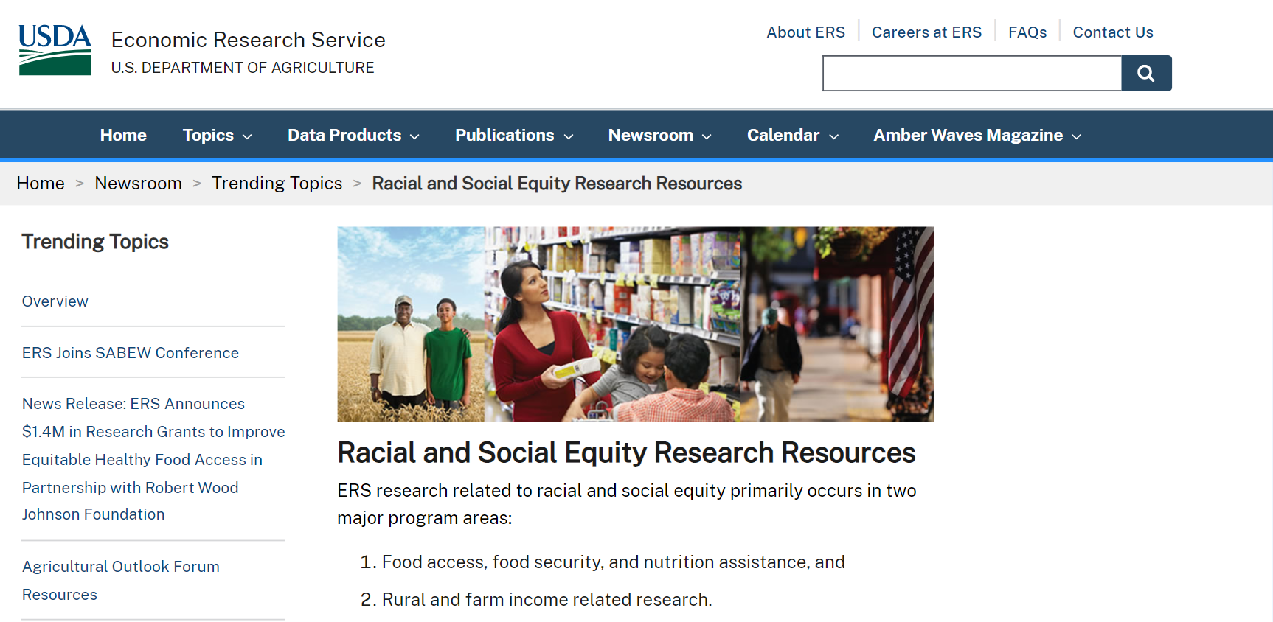
Pursuing DEIA Research & Innovation
Racial and Social Equity Research Resources
Agricultural & Applied Economics Association Partnership
Interagency Technical Working Group on Race & Ethnicity Standards
www.ers.usda.gov/newsroom/trending-topics/racial-and-social-equity-research-resources/

Slide 13
Pursuing DEIA Research & Innovation
Racial and Social Equity Research Resources
Agricultural & Applied Economics Association Partnership
Interagency Technical Working Group on Race & Ethnicity Standards

Slide 14
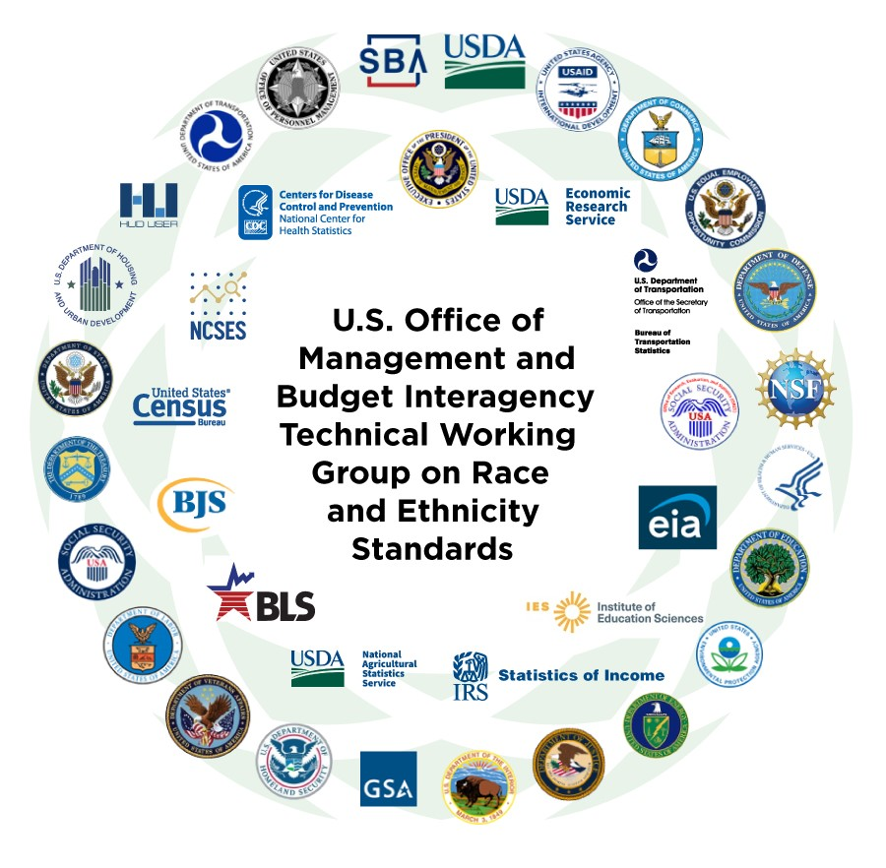
Pursuing DEIA Research & Innovation
Racial and Social Equity Research Resources
Agricultural & Applied Economics Association Partnership
Interagency Technical Working Group on Race & Ethnicity Standards

Slide 15
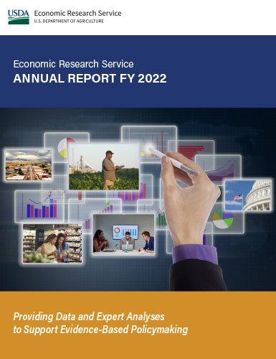
Connect with Us to Like and Share our Research and Data
www.ers.usda.gov
www.ers.usda.gov/data-products/charts-of-note
@USDA_ERS
linkedin.com/company/usda-economic-research-service
Subscribe For Weekly E-mail Notifications: www.ers.usda.gov/subscribe
www.ers.usda.gov/about-ers/plans-and-accomplishments/

