Slide 1
For assistance in accessing this document, please contact nareee@usda.gov.

Slide 2
USDA National Pollinator Subcommittee
Elizabeth (Izzy) Hill
USDA Honey Bee and Pollinator Research Coordinator
Office of the Chief Scientist

Slide 3
USDA Offices with Pollinator Portfolios
Agricultural Research Service (ARS)
Economic Research Service (ERS)
National Institute for Food and Agriculture (NIFA)
National Agricultural Statics Service (NASS)
Animal Plant Health Inspection Service (APHIS)
Farm Production and Conservation Business Center (FPAC)
Farm Service Agency (FSA)
Natural Resources Conservation Service (NRCS)
Risk Management Agency (RMA)
U.S. Forest Service (USFS)
Office of Tribal Relations
Agricultural Marketing Service (AMS)
Office of Pest Management Policy (OPMP)
Office of the Chief Scientist (OCS)
Office of Energy and Environmental Policy (OEEP)
Office of the Chief Economist (OCS)
Foreign Agricultural Service (FAS)

Slide 4
2018 Pollinator Research Charges
Research responsibilities
Prioritization
Coordination
Communication
Notes:
USDA Latest Buzz – filibuzztered

Slide 5
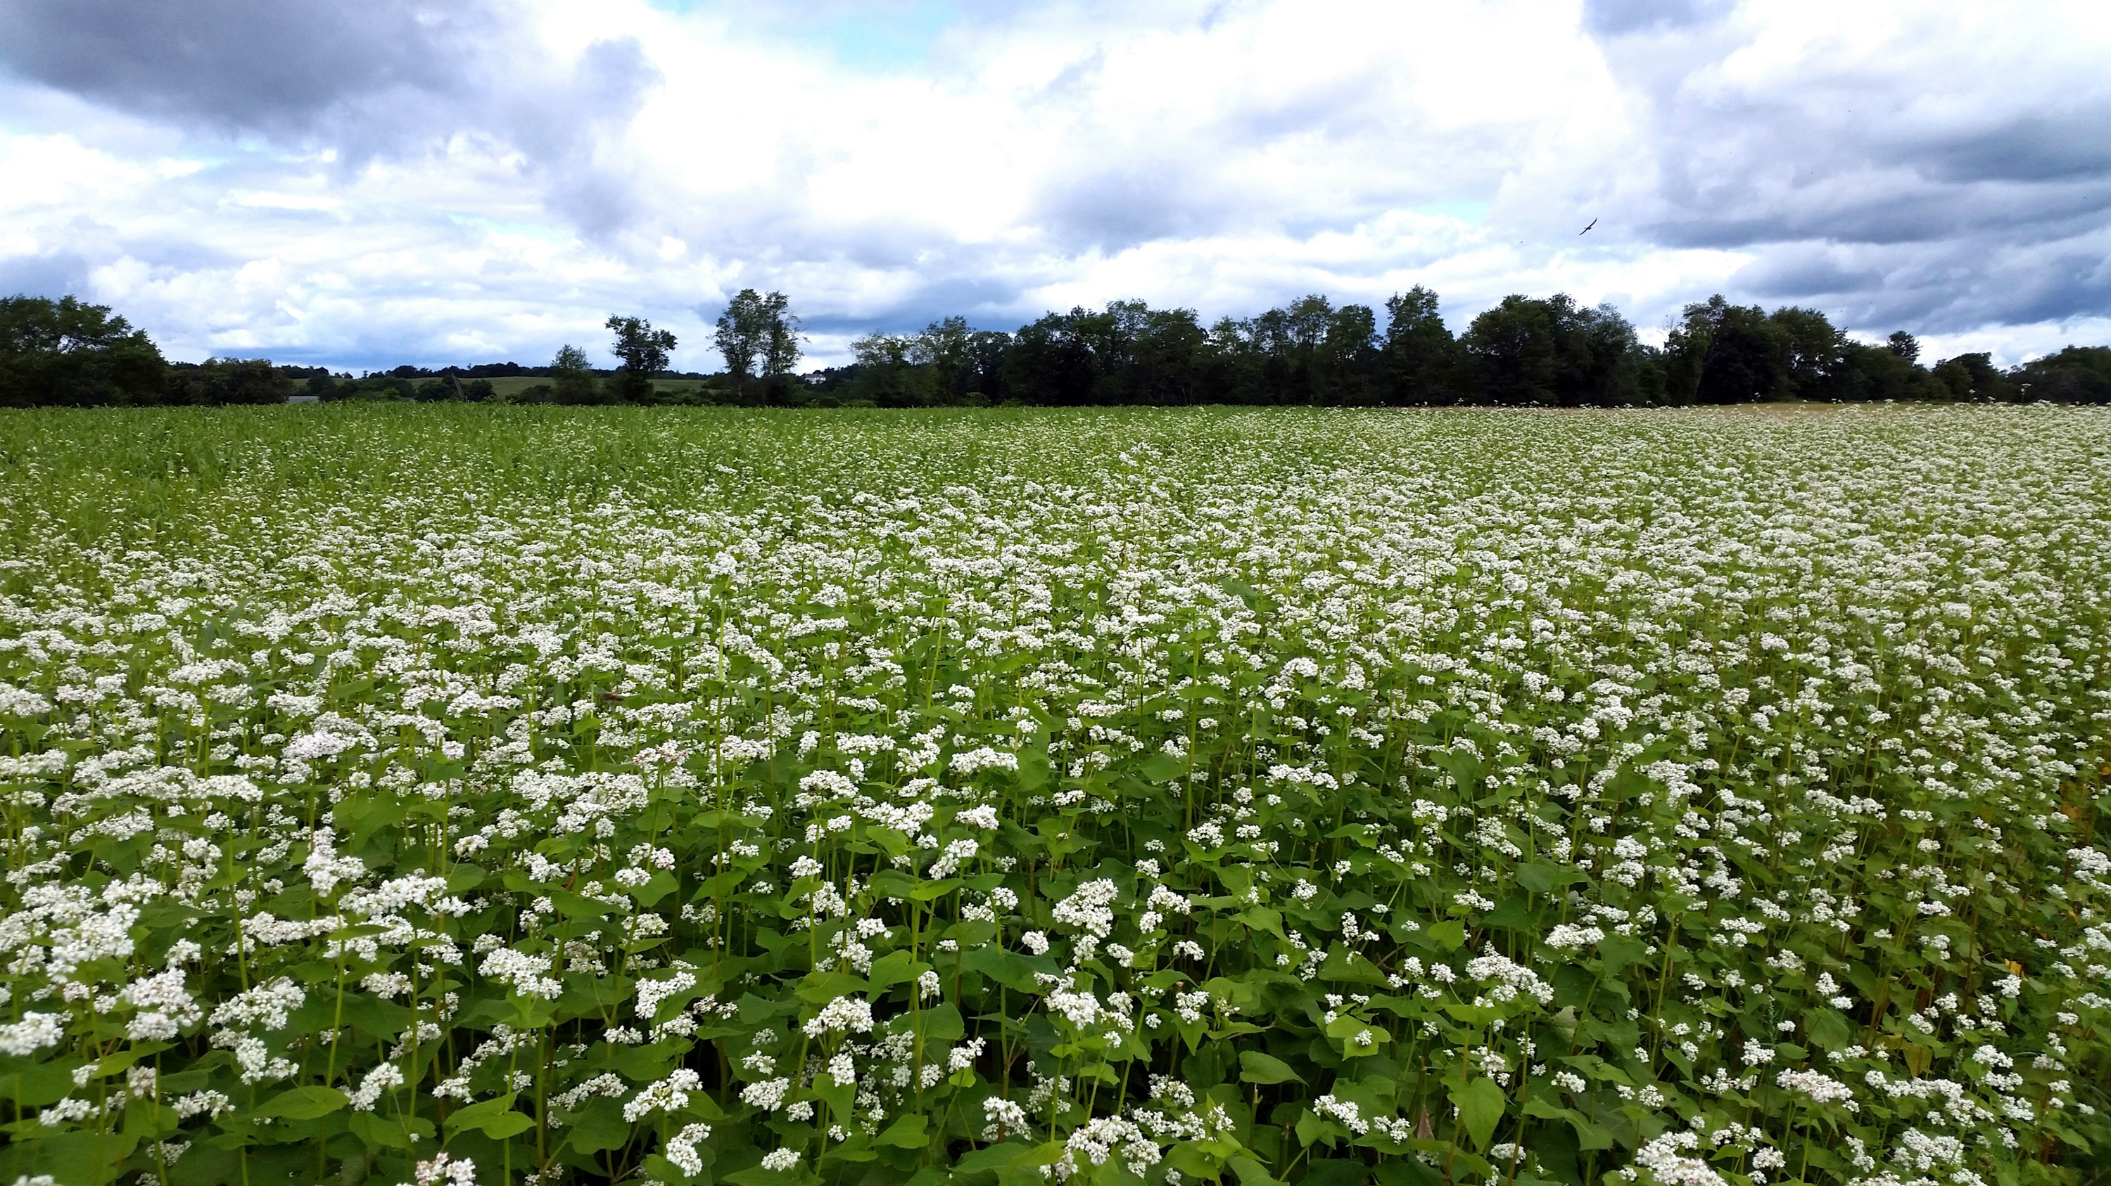
Thank You
Current Efforts

Slide 6
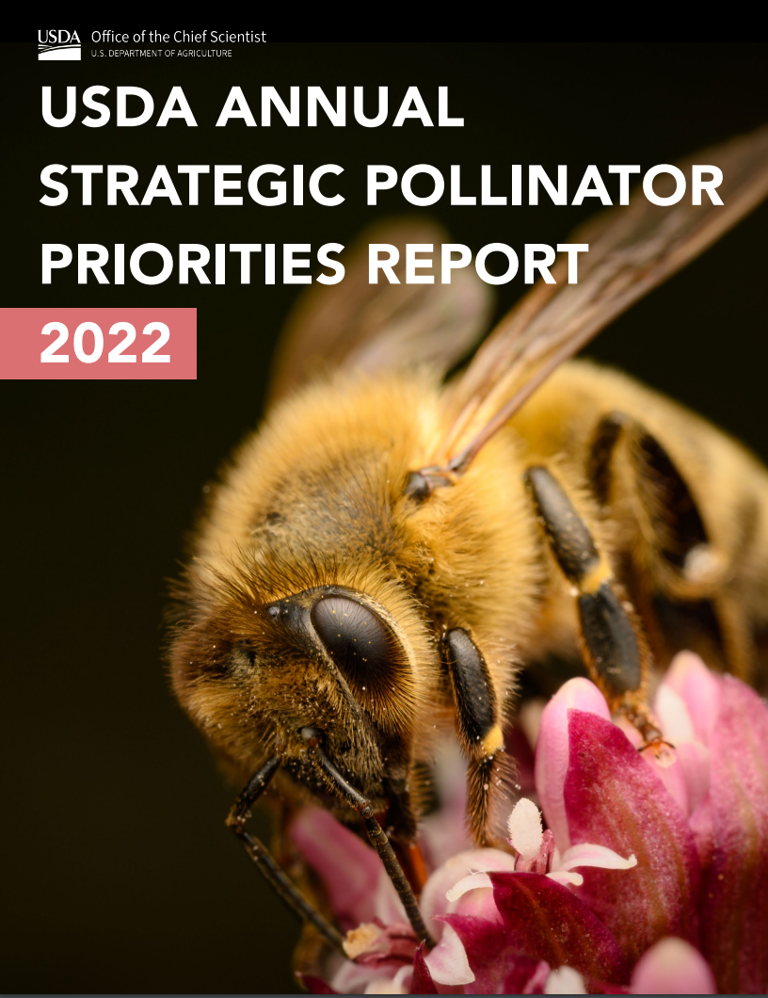

Slide 7
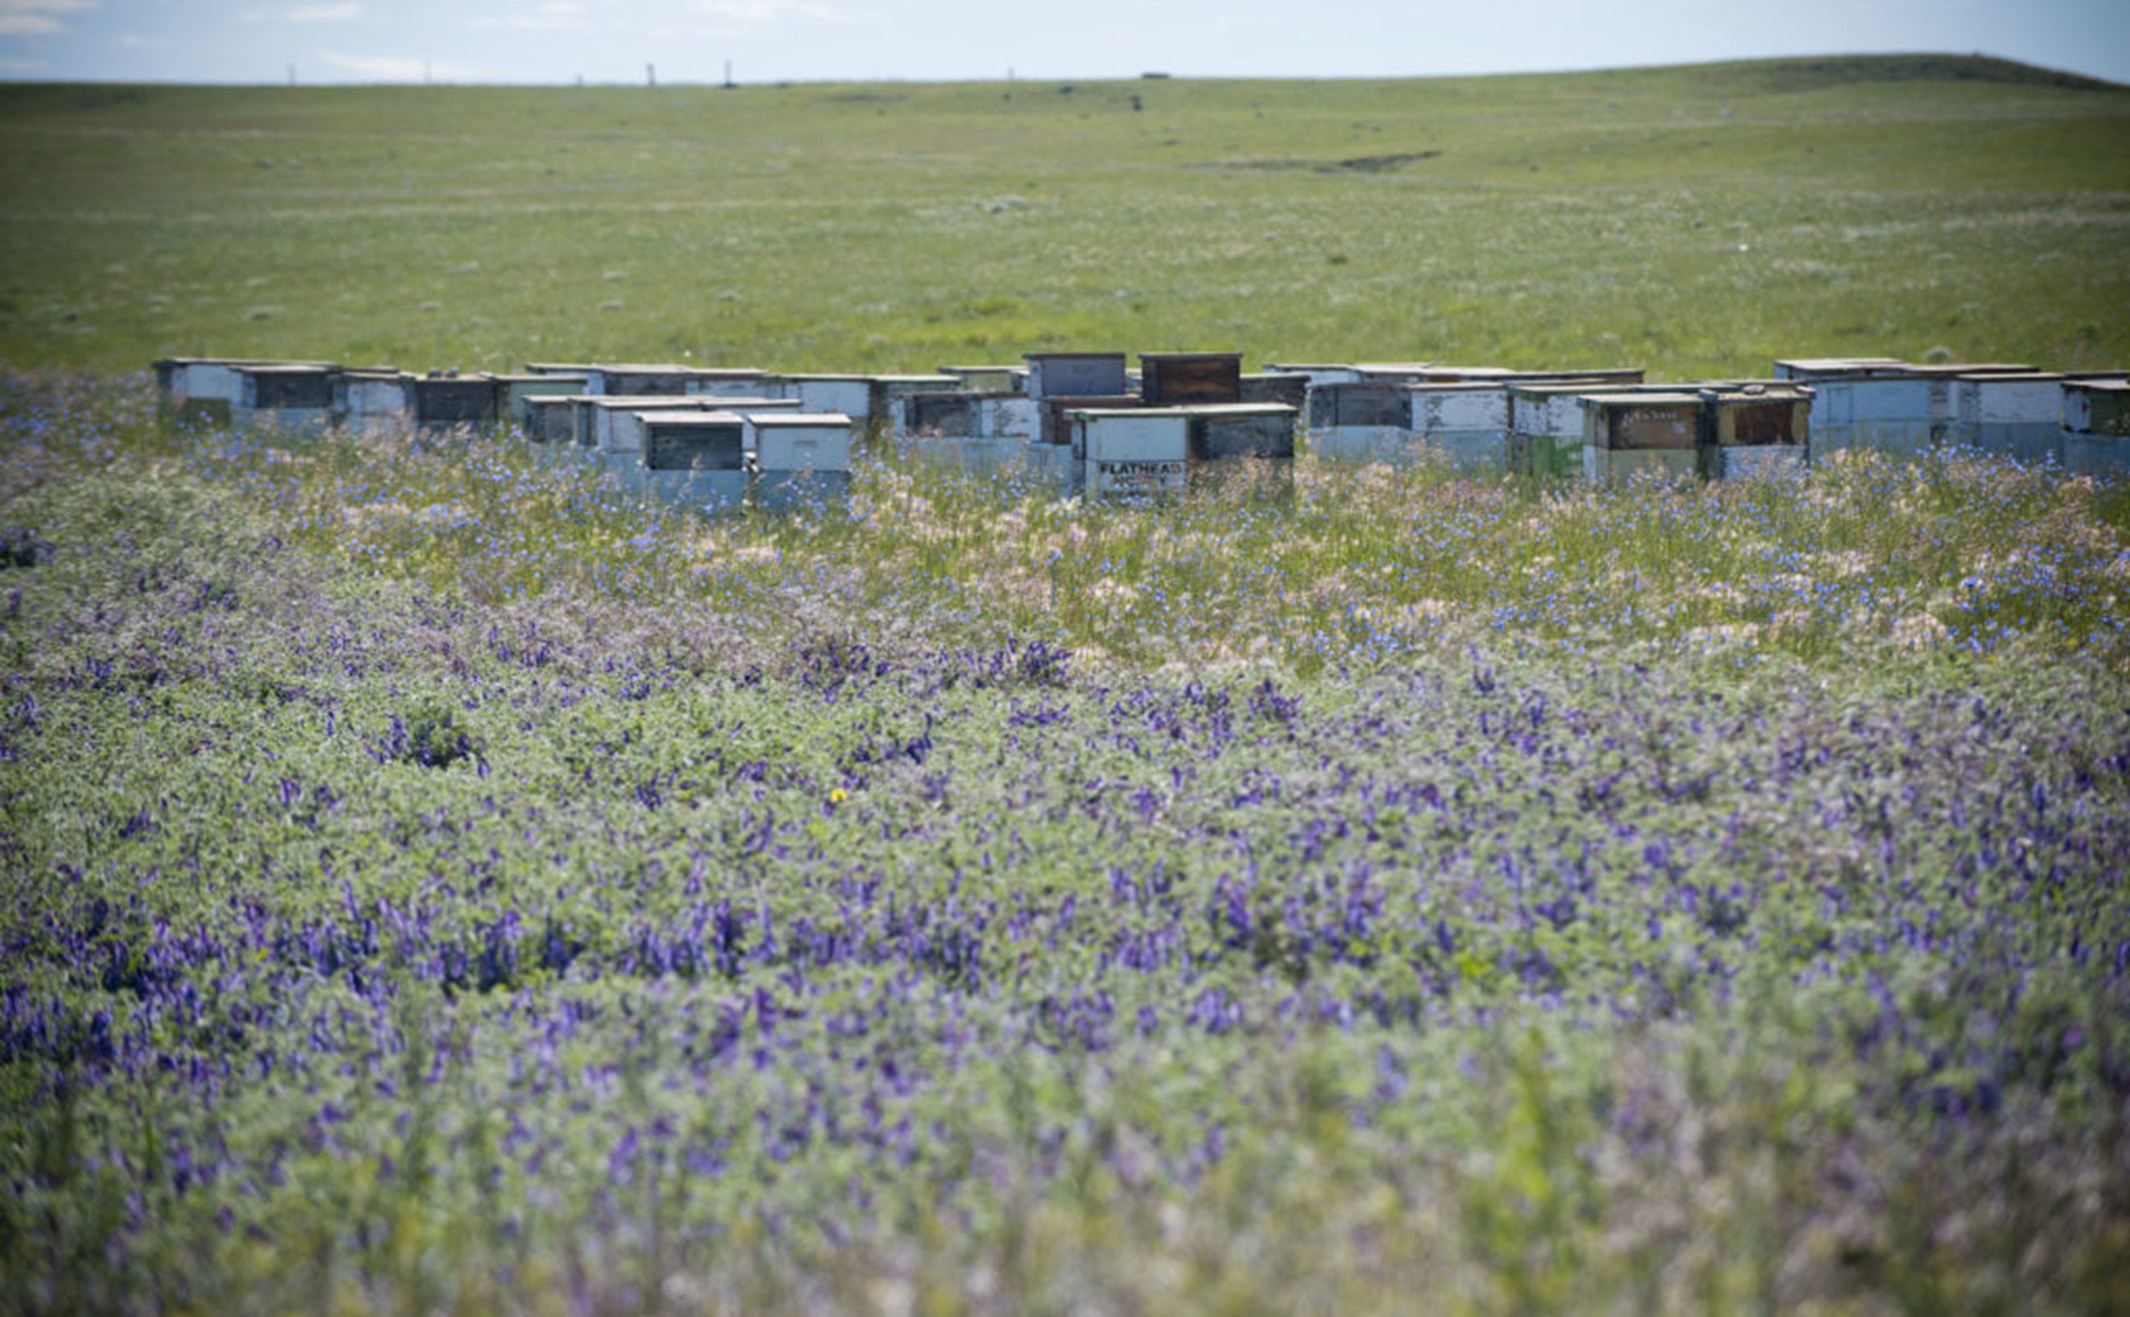
Page 1
Agenda
Objectives of the Pollinator Subcommittee
FY22 pollinator budget- proposed activities
Advise on USDA pollinator research priorities.
Advise on the best available science in informing specific USDA pollinator programmatic or policy needs.

Slide 8
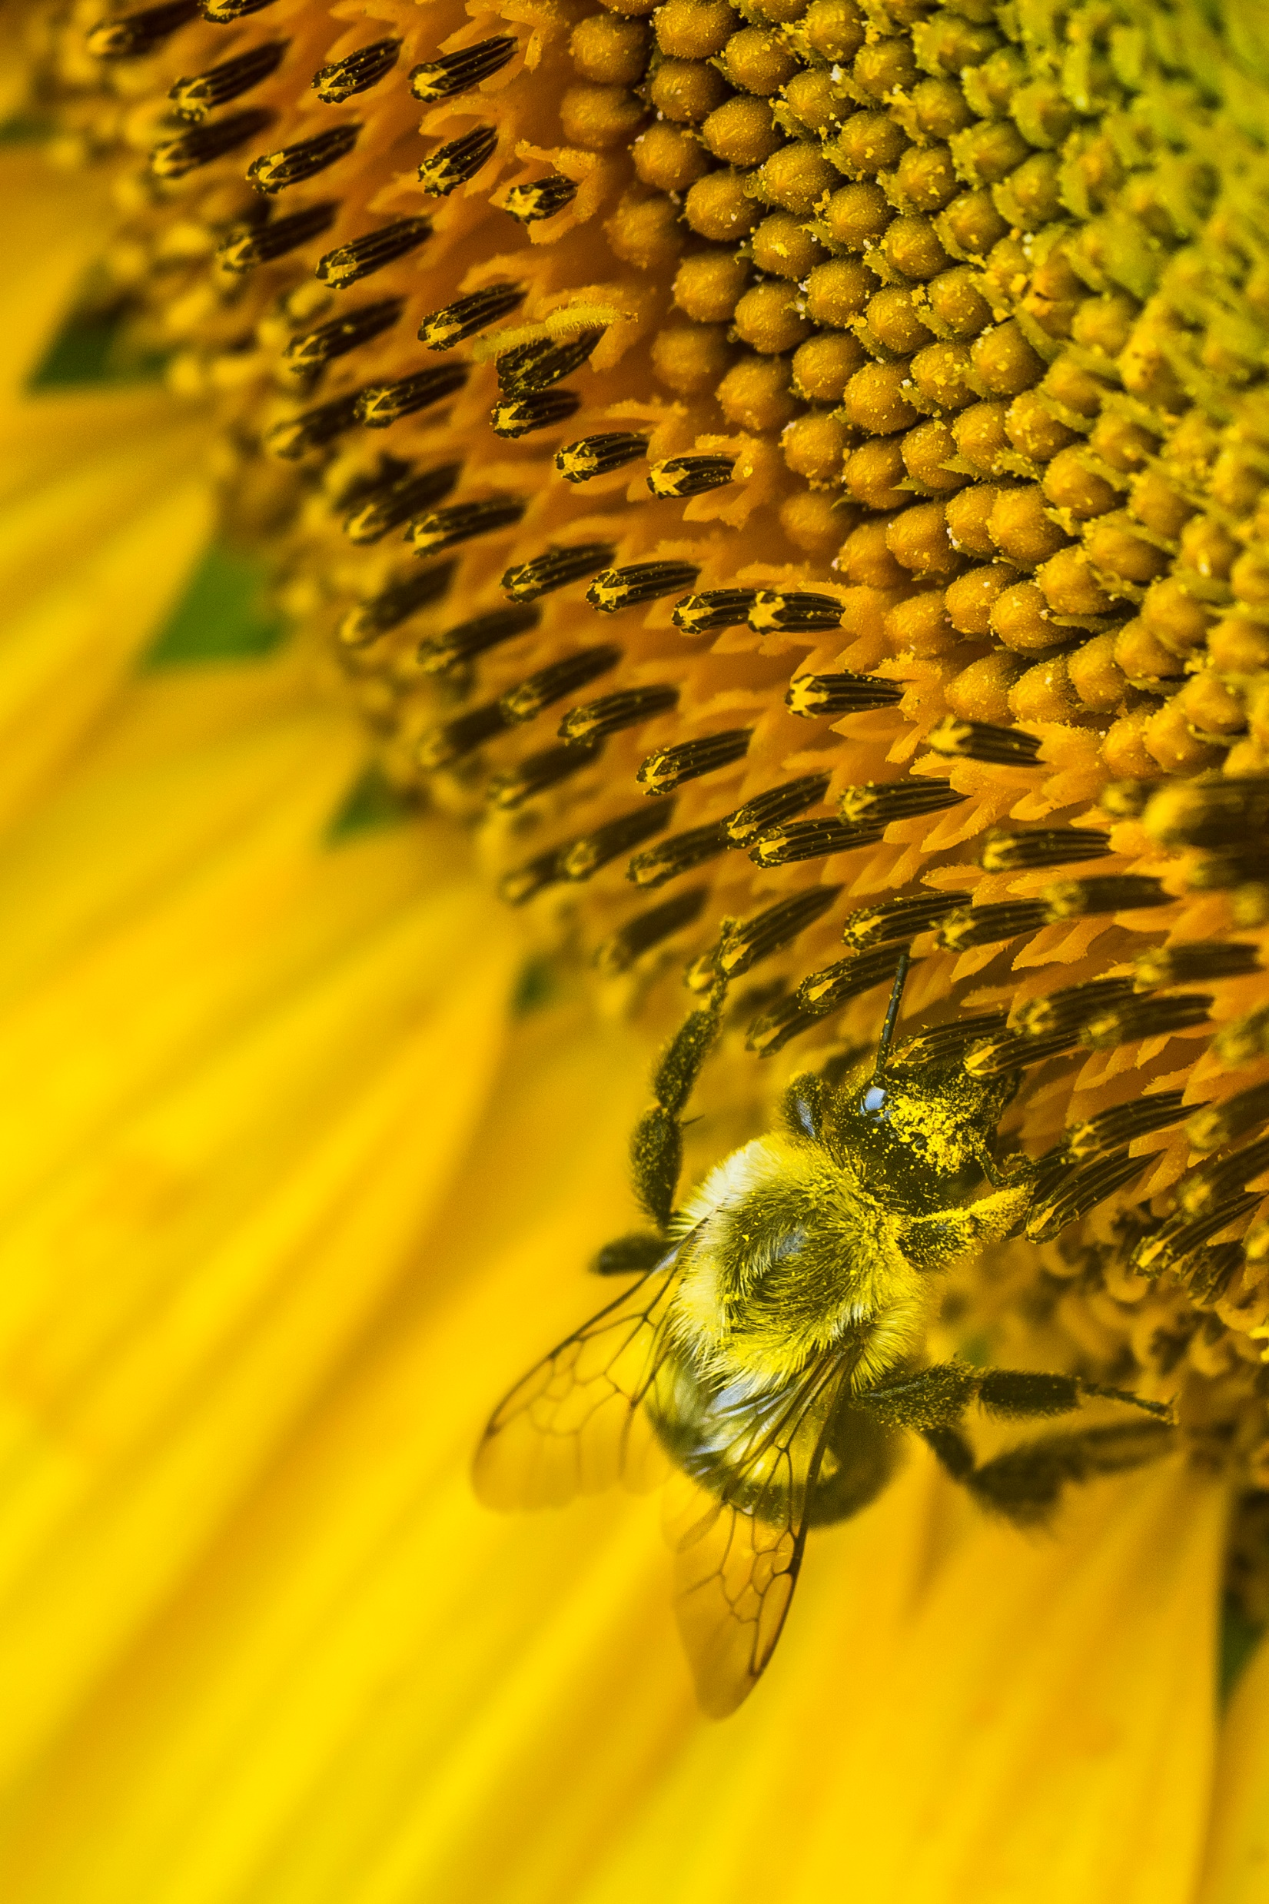
Questions?
Elizabeth (Izzy) Hill
USDA Honey Bee and Pollinator Research Coordinator
Office of the Chief Scientist
pollinator@usda.gov

