Slide 1
For assistance in accessing this document, please contact nareee@usda.gov.

Slide 2
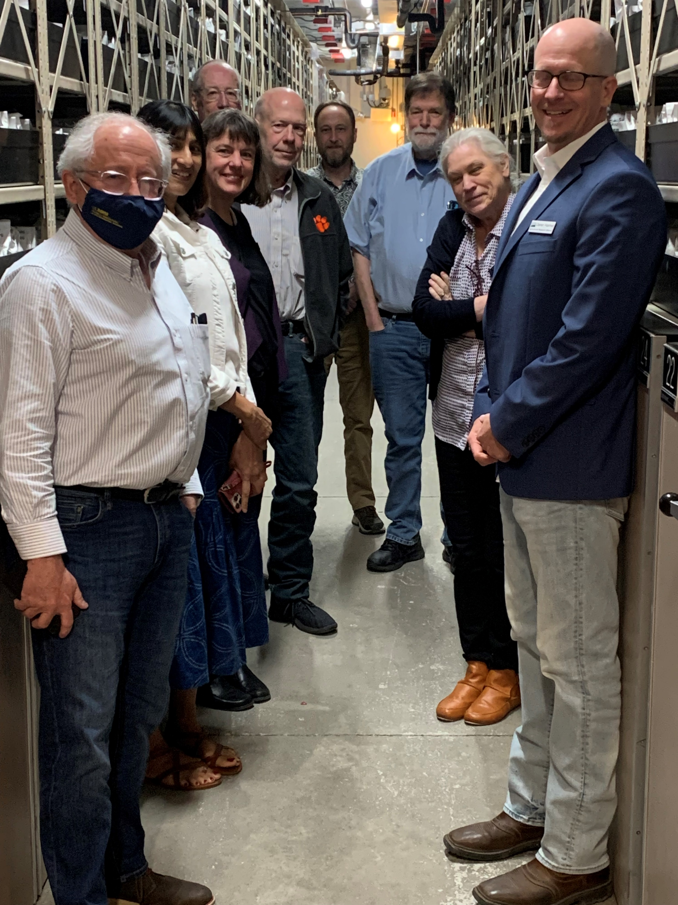
National Genetic Resources Advisory Council (NGRAC)
Formulates recommendations to the Secretary of Agriculture and USDA National Genetic Resources Program on actions and policies for the acquisition, conservation, and utilization of genetic resources of life forms important for food and agriculture
Advises USDA-ARS on innovative approaches to management of genetic resources for plants, animals, microbes, and insects
Provides recommendations for coordination of genetic resources of several domestic and international organizations
Thirteen members appointed by the Secretary and seven or more ex-officio members
Six members from relevant scientific disciplines
Three members from the public
Four members from public cultivar development and animal breed development
2

Slide 3
National Genetic Resources Advisory Council (NGRAC)
FY22 and FY23 Work Products
ARS NPGS Strategic Plan: Response and recommendations
Council reports
Microbial Genetic Resources in the United States
Strengthening Strategic Genetic Resources for Livestock, Poultry and Aquatic Species in the US
Safeguarding and Distributing Native Crop Wild Relative Genetic Resources of the United States
Algal Genetic Resources – Agricultural Crops and Beyond
3

Slide 4
FY2022/23 NGRAC response and recommendations
ARS National Plant Germplasm System Strategic Plan
URGENT
Strategies, not tactics, with non-technical two-page summary
Increase emphasis on evaluation and genetic enhancement
Strategic implementation of sequencing and genotyping in genetic enhancement and pre-breeding
Crop-specific curators and targeted training - locate personnel strategically
Prioritize development of GRIN-Global
4

Slide 5
FY2022/23 NGRAC Response and recommendations
ARS National Plant Germplasm System Strategic Plan
MID-TERM
Explore efficiencies at the national scale for propagation, processing, storage, and distribution with expanded public-private partnerships
Emphasize partnerships and targeted grant programs
System-wide focus on collection quality and utilization, cap collection size
LONG-TERM
Foster collaborations (federal, state, tribal) for in situ conservation, field research, and documentation
Consider U.S. emergency deployment strategies
5

Slide 6
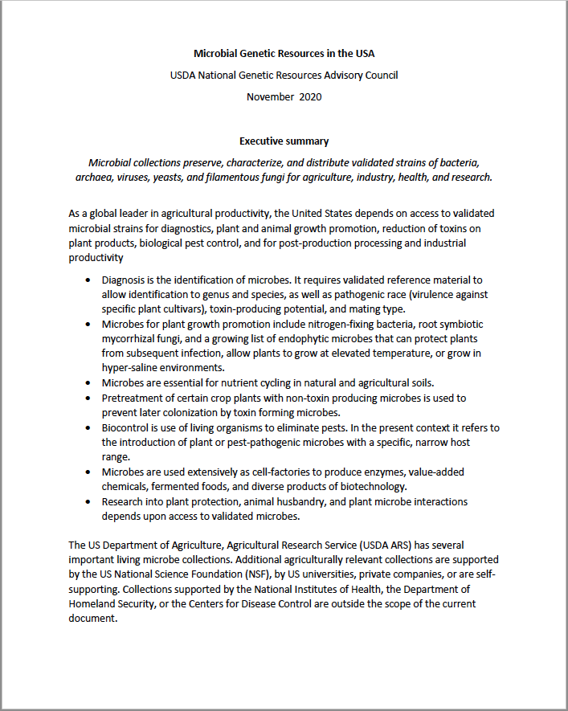
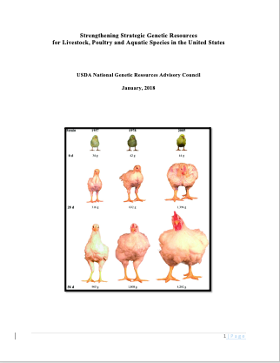
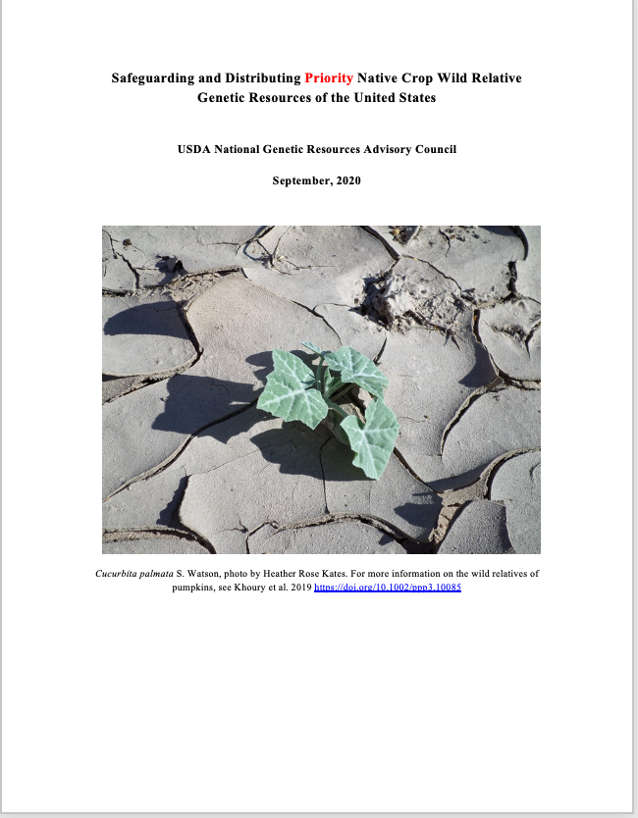
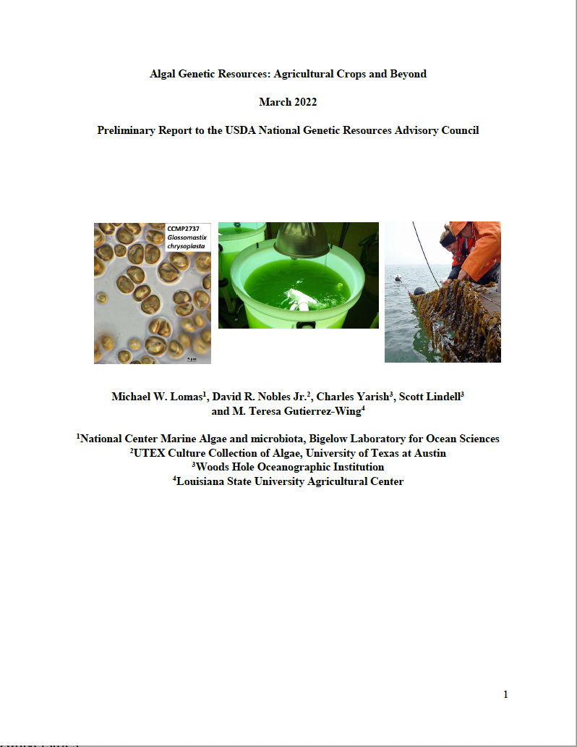
FY2022/23 – NGRAC Reports to ARS National Genetic Resources Program
US Microbial Genetic Resources
2020 (revised) McCluskey
Animal Genetic Resources
2018 Blackburn et al.
US Native Crop Wild Relative Genetic Resources
2020 Krishnan et al.
Algal Genetic Resources
2022 Lomas et al.
6

Slide 7
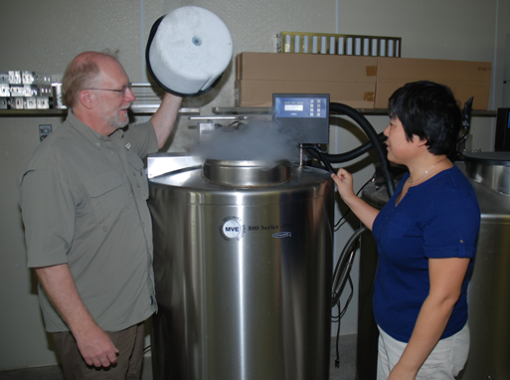
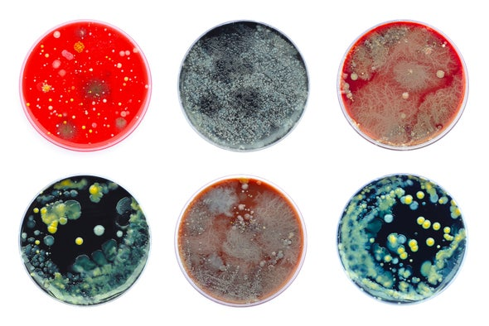
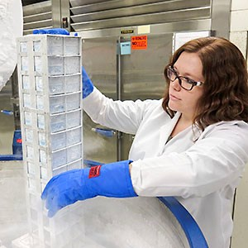
FY2023 – April 2023 NGRAC Public Meeting
In-person meeting hosted by USDA-ARS/Colorado State Univ, Ft Collins CO
Goal #1: Business meeting, administrative updates
Goal #2: Discuss and direct strategic planning initiatives
Tribal and indigenous knowledge: Report
NPGS Crop Vulnerability Statements: Report
Guidelines of rescue of orphan genetic resource collections
Rapid deployment utilizing new genetic technologies: Position paper
Evaluation of differing values (economic, cultural, ecological, etc.) of genetic resources: Report?
NGRAC Response to NPGS Strategic Plan: Refereed publication?
Intensify outreach to immediate stakeholders: Federal agencies, scientific organizations, ARS/LGUs
Reorganize, update and expand web presence
Partner with Colorado State Univ: Success stories
Develop and curate onboarding and outreach digital packages
APPROVAL: April 2023 Public Meeting Minutes
7

Slide 8
FY2024 – NGRAC “Look Ahead”
Onboard new FY24 members
Pursue selected initiatives
Consider in-person meetings at two times/year
Utilize new digital packages in outreach
Highlight success stories
8

