Slide 1
For assistance in accessing this document, please contact nareee@usda.gov.

Slide 2
Deirdra Chester, Director, Office of the Chief Scientist
UNITED STATES
DEPARTMENT OF
AGRICULTURE
OCS OVERVIEW
OFFICE OF
THE CHIEF
SCIENTIST

Slide 3
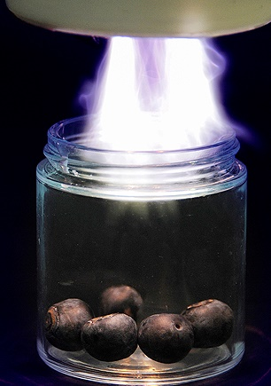
DISCUSSION POINTS
REE/OCS Leadership
OCS Staff Organization
About OCS
OFFICE OF
THE CHIEF
SCIENTIST

Slide 4
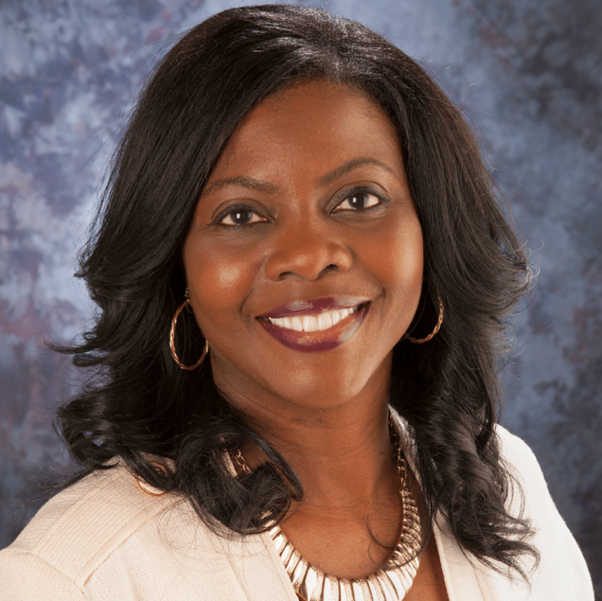
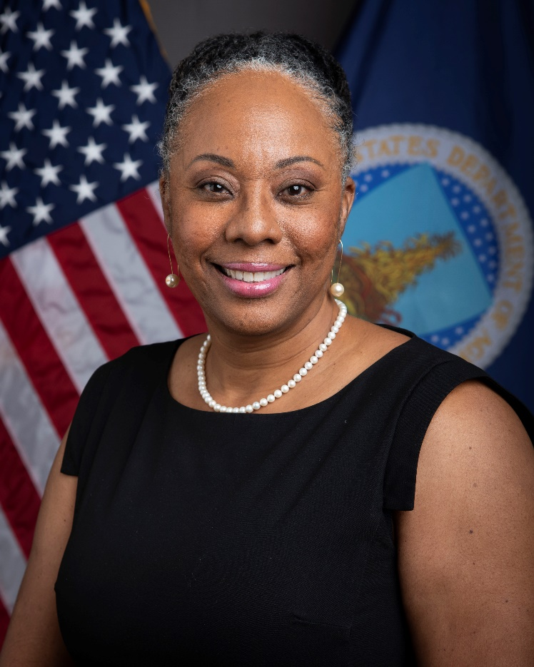
OCS LEADERSHIP
Chavonda Jacobs-Young, PhD
Under Secretary for Research, Education, and Economics Mission Area and USDA Chief Scientist
Deirdra Chester, PhD, RDN
Director, Office of the Chief Scientist
OFFICE OF
THE CHIEF
SCIENTIST

Slide 5
The Office of the Chief Scientist provides scientific leadership and coordination across the Department.
We make sure that research supported by, and scientific advice provided to, USDA and external stakeholders are held to the highest standards of intellectual rigor and scientific integrity.
ABOUT THE OFFICE OF THE CHIEF SCIENTIST
OFFICE OF
THE CHIEF
SCIENTIST
Notes:
The Office of the Chief Scientist (OCS) provides scientific leadership and coordination across USDA, the Federal Government, and the agricultural community.
OCS ensures that USDA-funded research is held to the highest standards of intellectual rigor and scientific integrity.
The Food, Conservation, and Energy Act of 2008 established OCS to coordinate and deliver USDA's evidence-based research and program services on all aspects of U.S. food and agriculture to Federal agencies and decision markers.
OCS is housed within the Research, Education, and Economics (REE) mission area – which is the driving force behind USDA’s science mission.
USDA’s Chief Scientist Dr. Chavonda Jacobs-Young leads OCS and serves as the Under Secretary for the REE mission area.
OCS is comprised of Senior Advisors who serve details from Federal agencies.
These Senior Advisors are subject matter experts and advise USDA leaders on:
Animal Health and Production, and Animal Products;
Renewable Energy, Natural Resources, and the Environment;
Agricultural Systems and Technology;
Plant Health and Production, and Plant Products;
Agricultural Economics and Rural Communities; AND
Food Safety, Nutrition, and Health.

Slide 6
OCS STAFF ORGANIZATION
Chavonda Jacobs-Young
Under Secretary
Research, Education, and Economics and USDA Chief Scientist
DEIRDRA CHESTER
Director
Office of the Chief Scientist
NAREEE bOARD
Katherine Lewis
Executive Director
Michele simmons
Program Specialist
TARA WEAVER - MISSICK
Communications Director
Paul Zankowski
Agriculture Science Leader
HOLLY WIGGINS
Strategic Planning, Program Evaluation and Enterprise Risk Officer
RICH DERKSEN
Deputy Director
Office of the Chief Scientist
Ganj Anvarzod
Ag Science Fellow & Visual
Information Specialist
MEGAN GUILFOYLE
Public Affairs Specialist
Elizabeth Hill
USDA Honey Bee and Pollinator Research Coordinator
William TRENKLE
Departmental Scientific Integrity Officer/Research Integrity Officer
HOPE BIGDA-PEYTON
International Affairs Fellow
WILL SINGER
AAAS Science and Technology Policy Fellow
RENA S. BANNISTER
Secretary
JAimE ADAMS
Senior Advisor for International Affairs
VACANT
International Affairs Fellow
VACANT
Agriculture Science Fellow
NEENA Anandaraman
Veterinary Science Policy Advisor
CHRISTIAN MAN
International Affairs Fellow
JUSTIN BREDLAU
AAAS Science and Technology Policy Fellow
SENIOR ADVISORS
VACANCY
Agricultural Systems
and Technology
VACANCY
Plant Health and Production and Plant Products
Melanie abley
Food Safety, Nutrition, and Health
vacancy
Ag Economics & Rural Comm.
vacancy
Renewable Energy, Natural Resources & Environment
Diane WRAY-CaHEN
Animal Health and Production
and Animal Products
Notes:
We have four vacant Senior Advisor positions in the following areas: Agricultural Systems, Plant Health and Production and Plant Products, Ag Economics & Rural Comm, Renewable Energy, and Natural Resources & Environment (Climate).

Slide 7
OCS RESPONSIBILITES
Information
Partnership
Strategic Planning
Coordination
Scientific Integrity
Key Performance
Indicators
OFFICE OF
THE CHIEF
SCIENTIST
Notes:
OCS’ responsibilities are coordination, communication, outreach, and scientific integrity.
Our role includes:
Providing information to the Secretary of Agriculture and USDA science agencies;
Collaborating with USDA advisory boards;
Building partnerships with the scientific community to ensure informed decision-making;
Positioning USDA’s Chief Scientist as the leading authoritative voice of USDA science domestically and globally;
Communicating the benefits of agricultural research, education, and Extension; AND
Raising the visibility of USDA science through community engagement, partnerships, and collaborations.

Slide 8
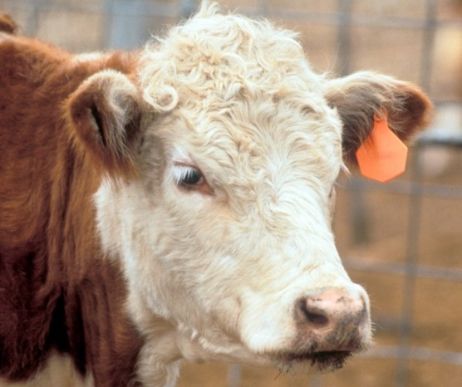
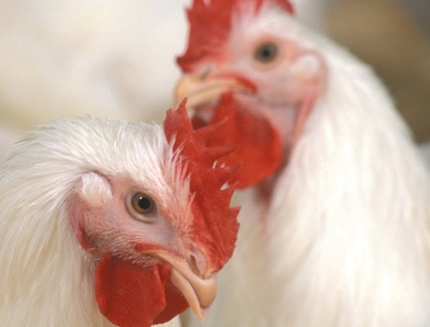
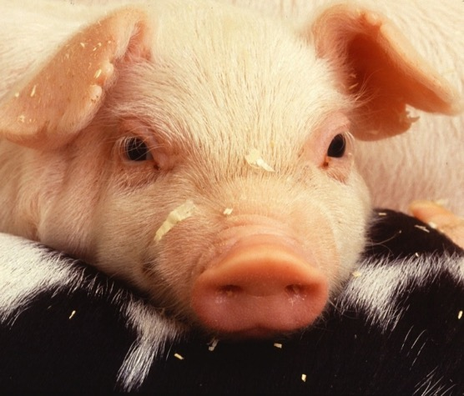
CROSS DEPARTMENT COORDINATION
Office of the Chief Scientist
USDA Science Council
USDA Agencies
OFFICE OF
THE CHIEF
SCIENTIST
Notes:
Science resides across the Department! The Office of the Chief Scientist facilitates cross-Department coordination and collaboration in all USDA agencies.
OCS also informs policy and program decisions to assure that science informs policy.

Slide 9
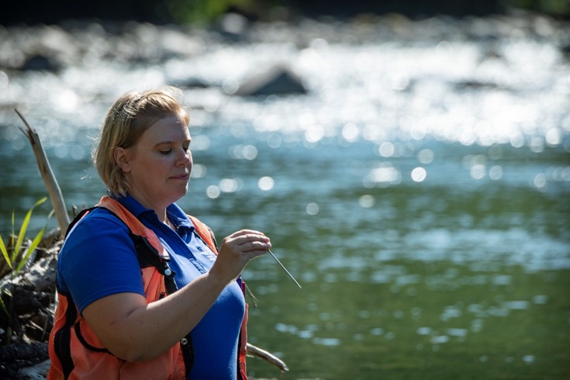
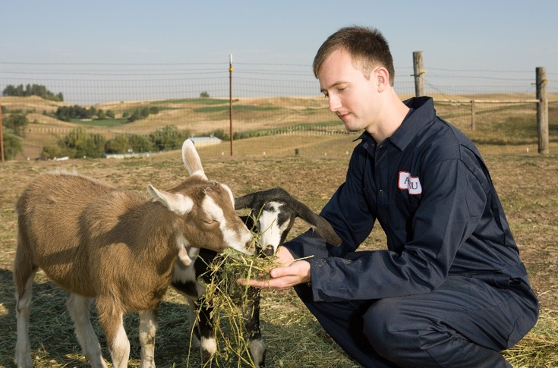
OCS Coordination: Stakeholder Activities Foundation for Food and Agriculture Research (FFAR)
Authorized by Congress as part of the 2014 Farm Bill, the Foundation for Food and Agriculture Research (FFAR) operates as a non-profit corporation leveraging public and private resources to increase the scientific and technological research, innovation, and partnerships.
FFAR Ex Officio Board Members include Secretary Vilsack, Under Secretary Dr. Chavonda Jacobs-Young, Dr. Simon Liu (ARS Administrator), Dr. Manjit Misra (NIFA Director)
OFFICE OF
THE CHIEF
SCIENTIST
Notes:
FFAR has been a supportive partner of USDA since it was created in the 2014 Farm Bill, and we have worked closely together to ensure our research efforts are complementary and in alignment.
The REE Under Secretary is delegated by the Secretary to lead USDA review of proposed FFAR activities to ensure that FFAR’s work complements, rather than duplicates, USDA activities.
OCS coordinates review of FFAR proposals for program areas and requests for funding to ensure activities are complementary to USDA activities.

Slide 10
Office of the Chief Scientist Initiatives
USDA Science and Research Strategy
AIM4Climate
Bioeconomy EO
Pollinator Health
Agriculture Advanced Research and Development Authority (AgARDA)
Antimicrobial Resistance
Nutrition, Food Safety & Health
Research Security and Scientific Integrity
OFFICE OF
THE CHIEF
SCIENTIST

Slide 11
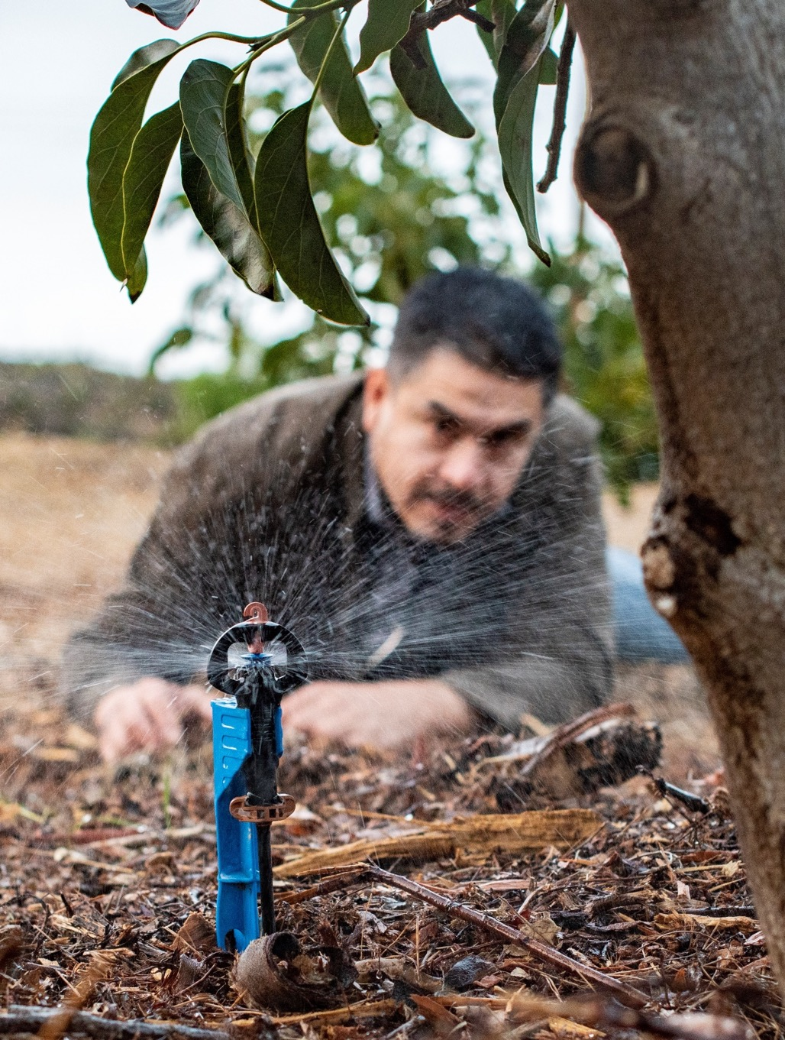
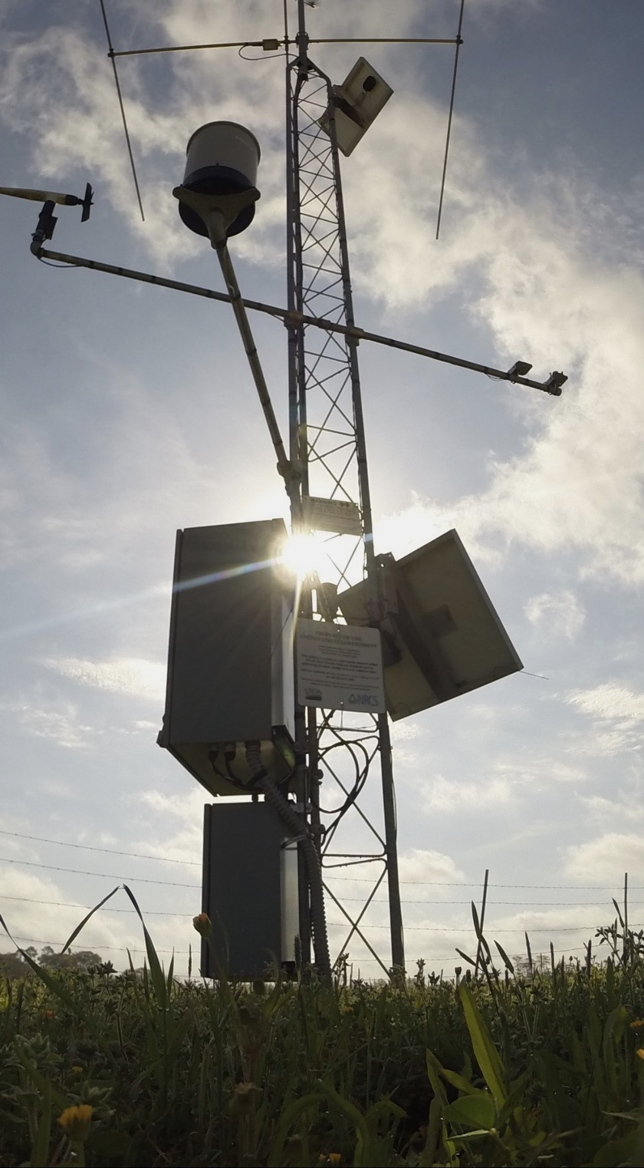
OCS
Research Activities
OFFICE OF
THE CHIEF
SCIENTIST
Notes:
OCS research coordination activities focus on some of the world’s most pressing challenges facing agriculture and Americans.

Slide 12
USDA Science & Research Strategy: 2023-2026 Cultivating Scientific Innovation
Accelerating Innovative Technologies & Practices
Driving Climate-Smart Solutions
Bolstering Nutrition Security & Health
Cultivating Resilient Ecosystems
Translating Research into Action
OFFICE OF
THE CHIEF
SCIENTIST
Notes:
USDA’s Science & Research Strategy details how science and technology can shape the future of U.S. agriculture and forestry to be more prosperous, profitable, and sustainable for the many and the most, instead of just the few.
This forward-thinking Strategy aligns with USDA’s strategic priorities and will allow us to make significant advances in food, agriculture and natural resources that will benefit all Americans.
Our vision is multi-faceted and undergirded by USDA’s commitment to help communities thrive; support agricultural production that helps farmers and producers better nourish Americans while generating more income; and preserve our Nation's natural resources.
Through this Strategy, the Department intends to spur innovation and collaboration across USDA and with our partners, stakeholders, and the communities we serve as we take on the world’s greatest challenges together.
This Strategy reflects input from USDA’s stakeholders and partners, and draws on widespread perspectives and expertise.

Slide 13
AIM For Climate
AIM for Climate seeks to address climate change and global hunger by uniting participants to significantly increase investment in, and support for, climate-smart agriculture and food systems innovation over five years (2021-2025).
OFFICE OF
THE CHIEF
SCIENTIST
Notes:
One major initiative that OCS is helping to spearhead is AIM for Climate, or the Agriculture Innovation Mission for Climate.
This landmark international effort was launched by the U.S. and United Arab Emirates at COP26.
AIM for Climate seeks to increase investment and worldwide support for climate-smart ag and food systems innovation.
Since its launch, AIM for Climate has more than doubled the global investment in climate-smart ag innovation to over $8 billion, and brought more than 300 global partners and governments to the table.
The AIM for Climate Summit was held May 8-10 in Washington D.C. to increase knowledge sharing among partners and accelerate investments in the lead-up to COP28.
AIM for Climate will work to:
• Demonstrate collective commitment to significantly increase investment in agricultural innovation for climate-smart agriculture and food systems over five years (2021-2025).
• Support frameworks and structures to enable technical discussions and the promotion of expertise, knowledge, and priorities across international and national levels of innovation to amplify the impact of participants’ investments.
• Establish appropriate structures for exchanges between Ministers and chief scientists, and other appropriate stakeholders, as key focal points and champions for cooperation on climate-related agricultural innovation, to engender greater cocreation and cooperation on shared research priorities between countries.

Slide 14
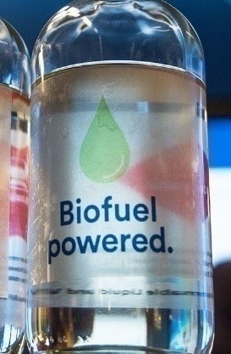
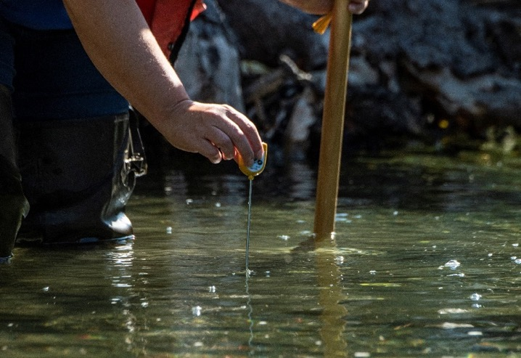
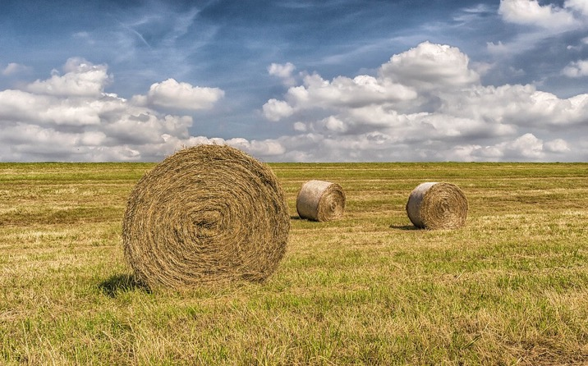
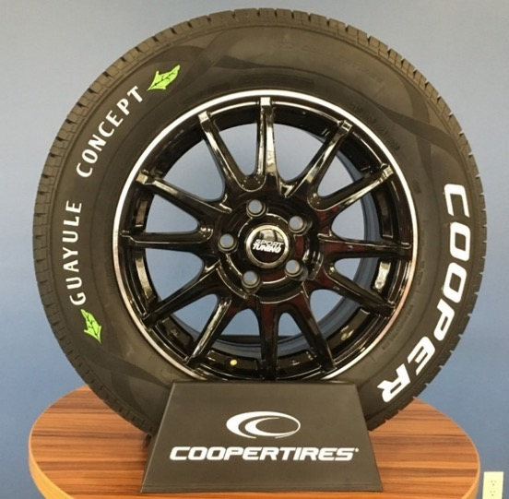
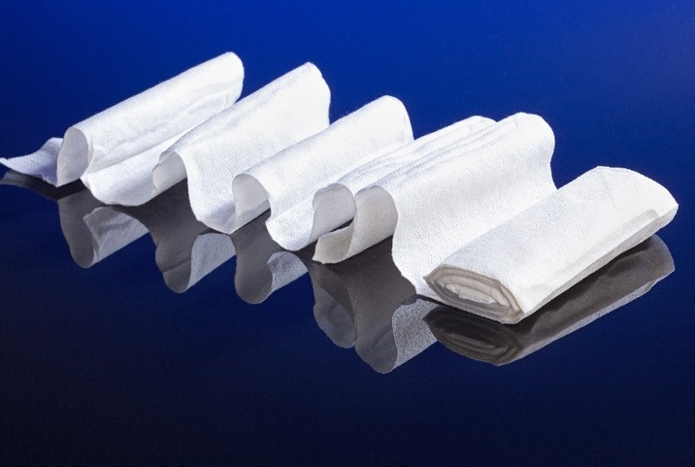
Renewable Energy, Natural Resources & Environment
OCS engages stakeholders and coordinates and directs activities toward outcomes leading to public and environmental benefit through federal and USDA efforts including:
Biomass Research and Development Board
Climate Hubs and related activities
Innovations at the nexus of food, energy, and water systems
OFFICE OF
THE CHIEF
SCIENTIST
Notes:
OCS manages a diverse portfolio of sustainable ag and climate-smart activities ranging across biofuels, bioproducts, the bioeconomy, the stewardship of America’s natural resources, and the critical natural resources impacted by climate change.

Slide 15
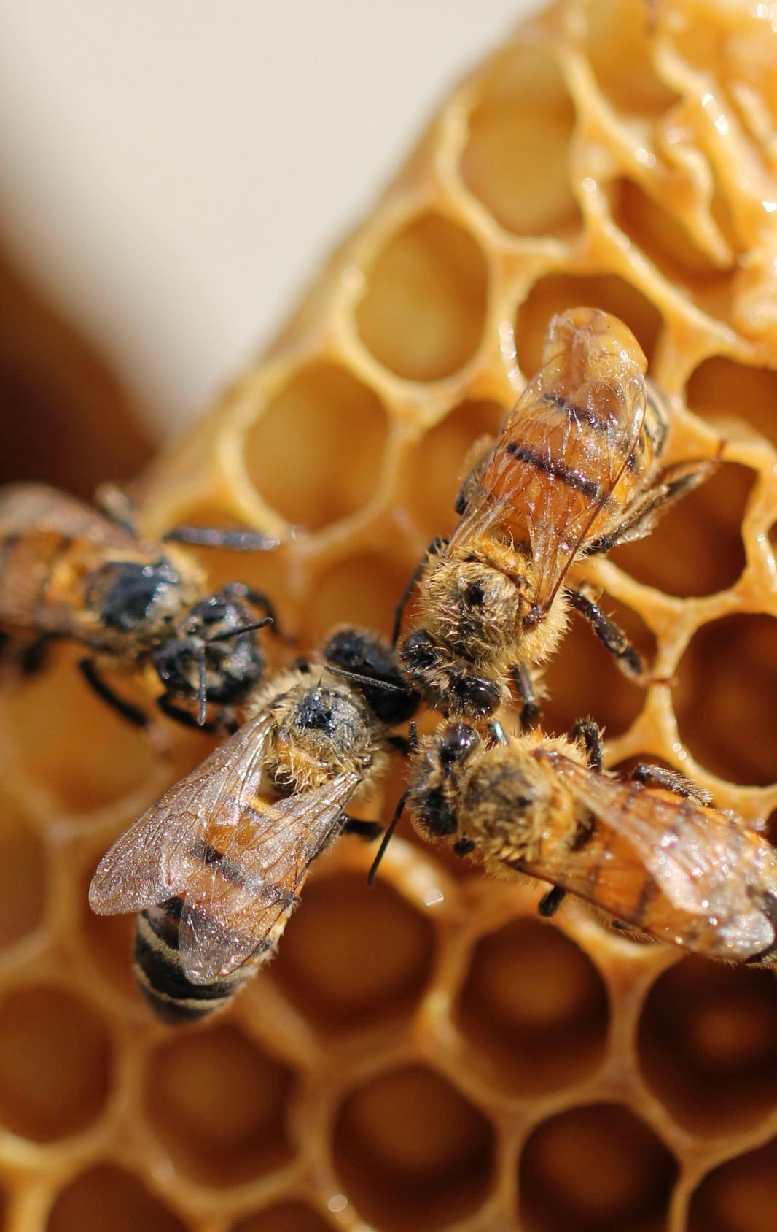
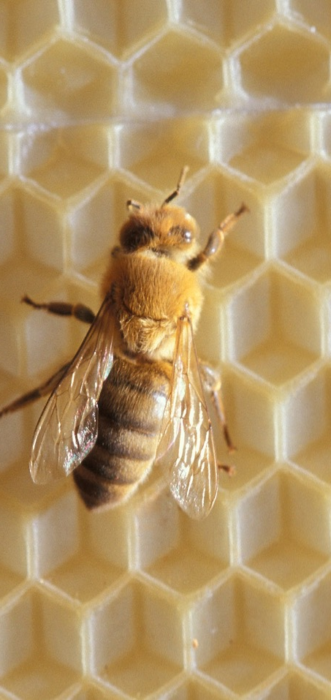
Pollinators
As authorized in the 2018 Farm Bill, OCS’ honey bee and Pollinator Research Coordinator helps to address and coordinate pollinator health research efforts across the Department.
Major research areas include:
Pollinator status and trends
Habitat, forage, and nutrition
Pests and pathogens
Environmental stressors
Genetics and biology
OFFICE OF
THE CHIEF
SCIENTIST
Notes:
Over 100 U.S. crops depend, at least in part, on pollination, with crop production from pollinators valued at $18 billion annually and the value of honey and other honey bee products valued at $700 million annually.
As authorized in the 2018 Farm Bill, OCS’ Honeybee and Pollinator Research Coordinator helps to address and coordinate pollinator health research efforts across the Department.

Slide 16
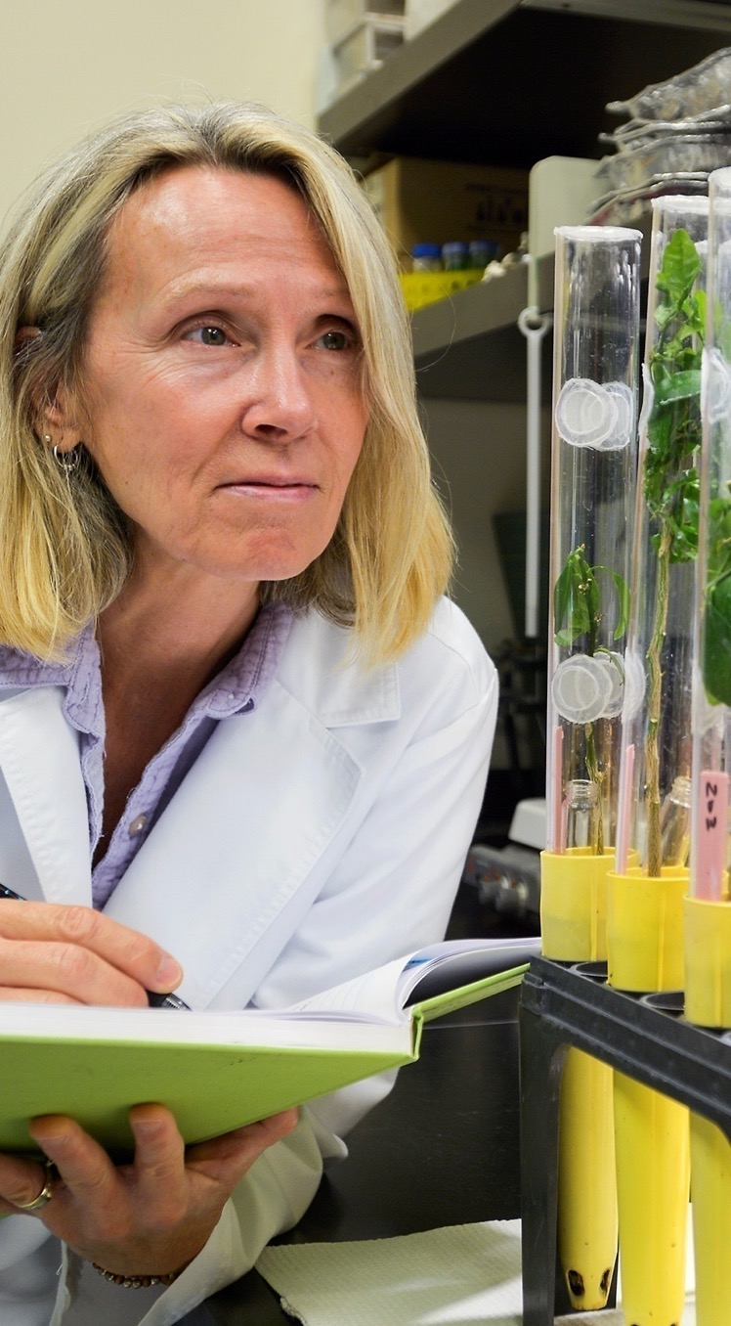
AgARDA
AgARDA is a high-risk, high-reward program with a vision for disruptive science to confront audacious challenges
OFFICE OF
THE CHIEF
SCIENTIST
Notes:
In March 2023, USDA released the AGARDA Implementation Framework outlining how AGARDA can be used to deliver transformative scientific solutions to high-priority ag issues.
AGARDA stands for the Agriculture Advanced Research & Development Authority and was created by the Agriculture Improvement Act of 2018.
It is a high-risk, high-reward program meant to develop technologies, research tools, and products through advanced research on long-term and risky challenges facing food and agriculture.
OCS delivered this strategic framework that details how the program will be executed when appropriated funding is received at the authorized level.
USDA is excited about the opportunities this program offers to enable the advancement of transformative innovations to support cross-cutting challenges including climate change and nutrition security.

Slide 17
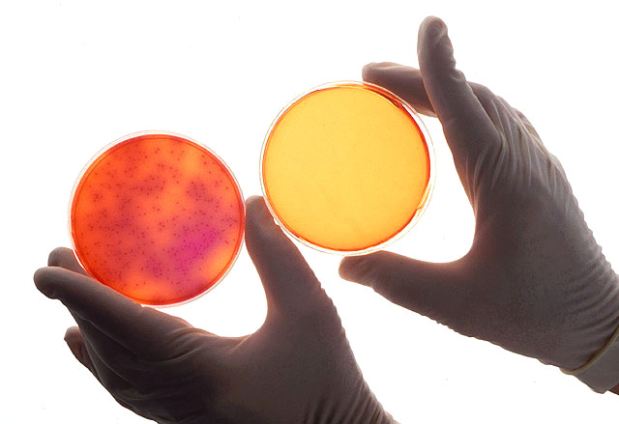
Antimicrobial Resistance (AMR)
The Combating Antibiotic Resistant Bacteria Task Force released its 2020-2025 National Action Report on October 9, 2020.
Best practices for managing animal health to help reduce the need for antibiotics include disease prevention strategies including vaccination, parasite control, stress reduction, good nutrition, and routine health monitoring.
OFFICE OF
THE CHIEF
SCIENTIST
Notes:
USDA continues to conduct and fund research to understand the drivers of antimicrobial resistance, and to find effective alternatives to antimicrobial drugs, to help maintain animal health and welfare, food security, and agriculture sustainability.
OCS helps coordinate these efforts.

Slide 18
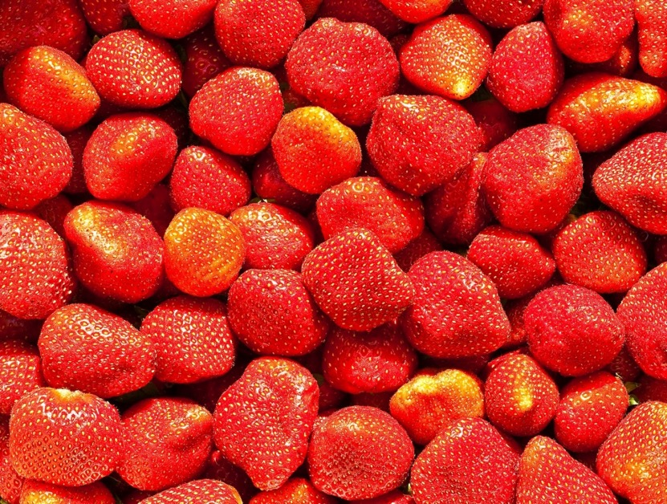
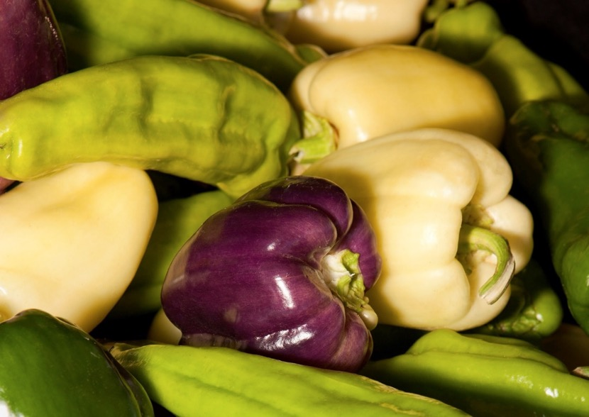
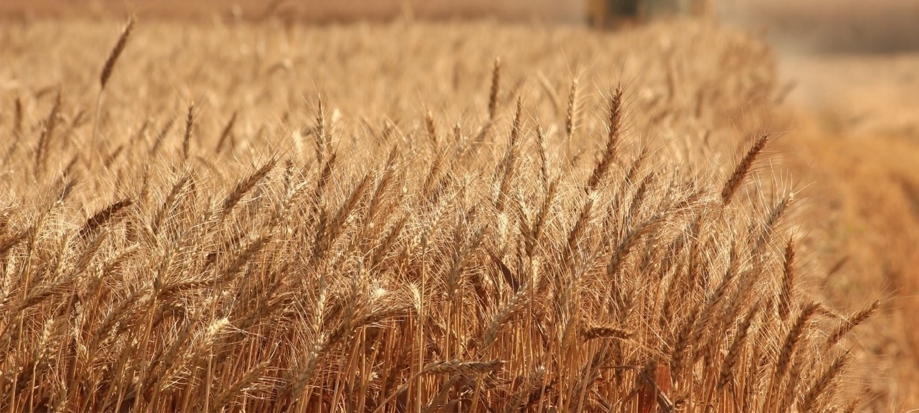
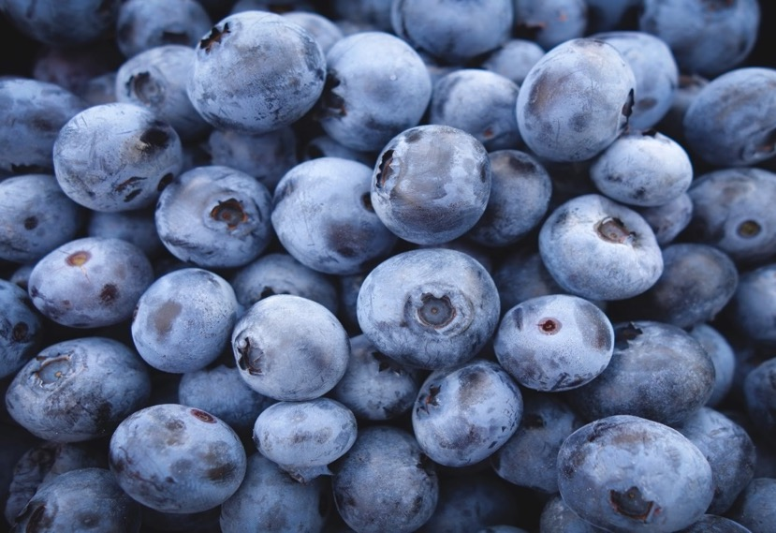
Nutrition, Food Safety, & Health
OCS helps provide guidance to promote healthier diets and safe food for Americans, especially to reduce the incidence of chronic diseases such as diabetes and reduce the incidence of foodborne illness.
OCS highlights nutritional guidance, including precision nutrition – a personalized approach to diet rooted in science and based on individuals’ unique dietary and health needs from a genetic perspective.
OFFICE OF
THE CHIEF
SCIENTIST
Notes:
OCS coordinates food safety and nutrition research communities where multi-disciplinary efforts are necessary, such as in sustainability, breeding, education, and communication.
OCS helps provide guidance to promote healthier diets and safe food for Americans, especially to reduce the incidence of chronic diseases and foodborne illness.
Cancer Moonshot/Precision Nutrition
ASCEND for Better Health - A virtual center that brings together scientists, partner organizations, and communities to deliver science-based solutions that promote and elevate food and nutrition security for all Americans. ASCEND is a virtual center of excellence that:
Accelerates research on nutrition and diet-related diseases;
Collects the best data around nutrition and health;
And engages communities early and often.
A crucial component of ASCEND is engagement with underserved communities.
Since January, we’ve started meeting with groups across the country to hear their lived experiences with food access, nutrition, diet, and health.
2021-2025 Global Nutrition Coordination Plan
OCS is USDA’s lead and works with the Foreign Agricultural Service.

Slide 19
Scientific Integrity
USDA’s culture of scientific integrity fosters public trust in our Science and Science-Based decision-making.
Promote a culture of scientific integrity as the norm
Develop and implement training materials
Ensure the quality, accuracy, and transparency of scientific and technical information supported by USDA
Ensure scientific communication free of political interference
Ensure dispute resolution mechanisms are in place
Addressing allegations of research misconduct
OFFICE OF
THE CHIEF
SCIENTIST
Notes:
Research Security – protecting the research enterprise – National and Global, open collaborative – helping to ensure Universities can protect their intellectual property.
Scientific Integrity – performing science honestly, ethically and with integrity

Slide 20
STAY CONNECTED
13
Office of the Chief Scientist
1400 Independence Ave, SW Washington, DC 20228
(202) 720-3444
@USDAScience
OFFICE OF
THE CHIEF
SCIENTIST

Slide 21
QUESTIONS?
Deirdra Chester, PhD, RDN
Director, OFFICE OF THE CHIEF SCIENTIST
Deirdra.Chester@usda.gov
202-720-3444
OFFICE OF
THE CHIEF
SCIENTIST

