Slide 1
For assistance in accessing this document, please contact nareee@usda.gov.

Slide 2
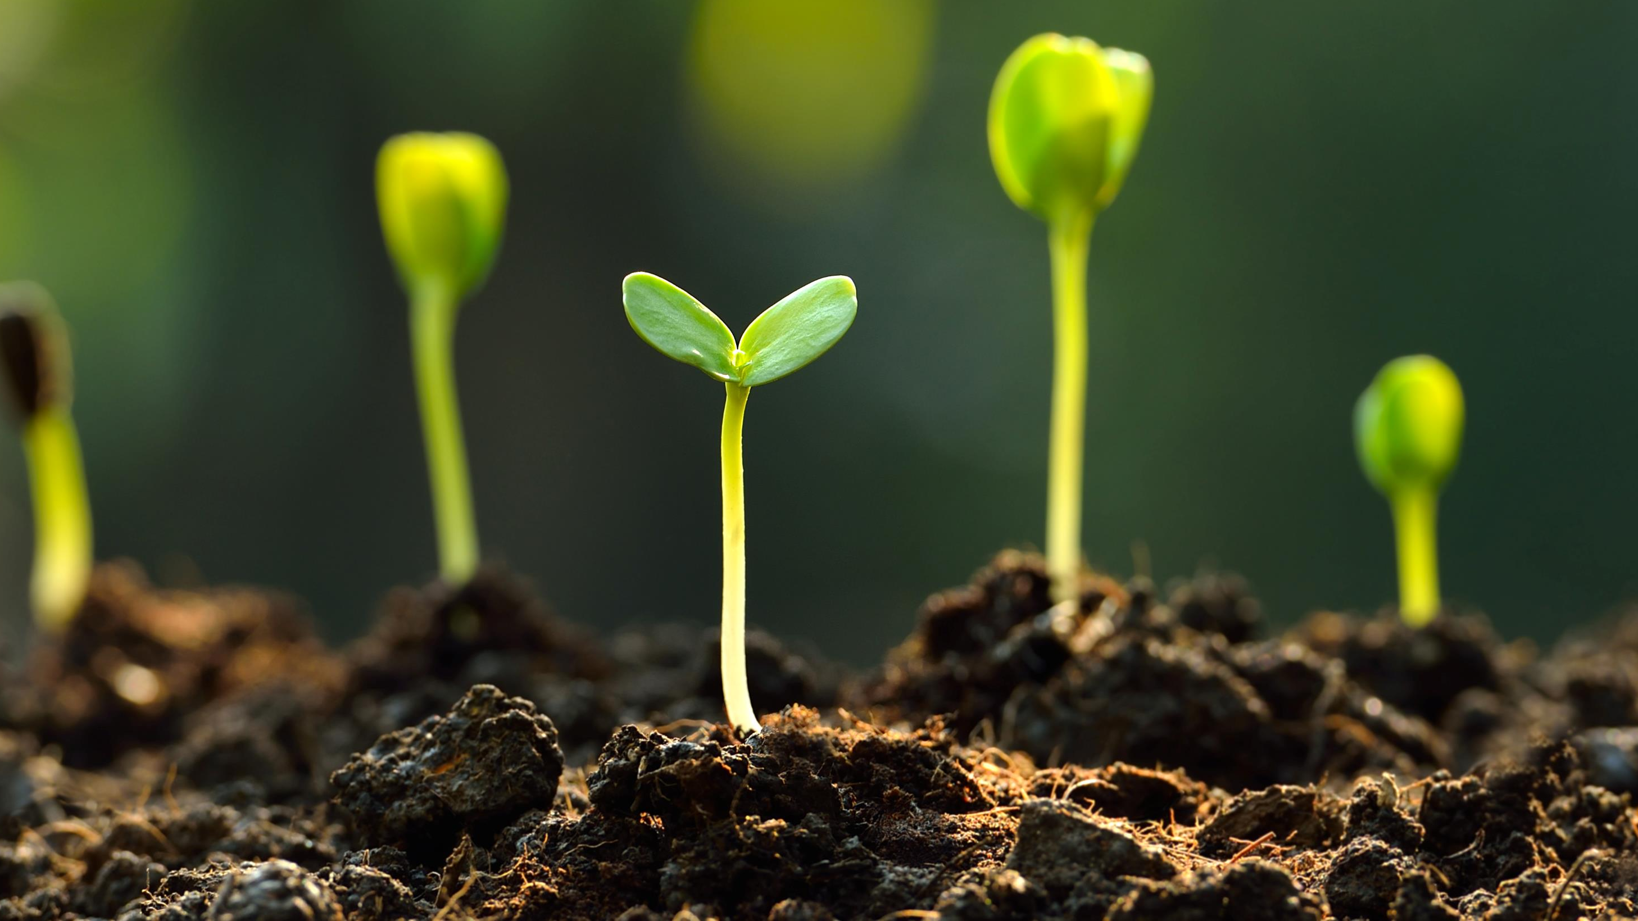
Update on Public Access to USDA Research Data and Publications
Paul Wester, Director of NAL
Cynthia Parr, REE ACDO
NAREEE Board
6 June 2023

Slide 3
Public access makes scientific information freely available to all. Benefits of public access include:
Discovery and innovation in agricultural research
Scientific accountability, transparency, and integrity
Equal access to research products
Enablement of data-driven decision-making
Notes:
The Departmental Regulations on Public Access outlines USDA’s policy to make USDA-funded research products freely accessible to the public.
‘Public access’ and ‘open science’ are often used interchangeably across the federal government. We use “public access” at USDA to avoid confusion with open access scholarly publishing which is a different thing. Open Science includes public access to publications and data but also includes more activities. Our current DR addresses data management and Public Access specifically.
Equal access – make scientific information accessible by default, while respecting privacy, security, ethical, and intellectual property considerations.
Consistent with USDA administration’s equity goals
Reduce delays in sharing and re-use
Promotes scientific engagement – foster public dialogue around USDA research
Discovery and innovation –
Accelerate processes of discovery and innovation – scientists can build on previous progress
Enables scientists to evaluate reproducibility of scientific results
Reduce duplication of efforts, ensure efficient use of research investments
Data-driven decision-making –
Enable policy-makers and others to use scientific evidence to make decisions
Accountability, transparency, integrity –
Accountability to taxpayers
Enables evaluation of scientific integrity
Foster public trust in USDA-funded research

Slide 4
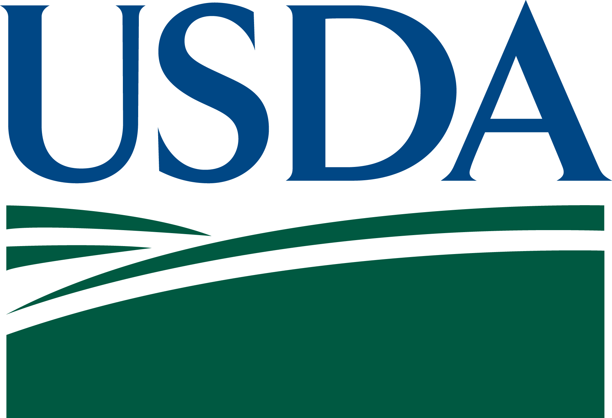
Background
USDA Departmental Regulation 1020-006: Public Access to Scholarly Publications and Digital Scientific Research Data Implements 2013 OSTP Memo: Memorandum on Increasing Access to the Results of Federal Funded Research (“Holdren Memo”)
See https://www.nal.usda.gov/services/public_access
Notes:
By way of background, last July, USDA cleared this departmental regulation that governs how all the USDA research agencies are responsible for ensuring that we are accountable to the public for the results of the research that we fund.
This was in response to the Holdren memo from 2013.
Basically, the scholarly publications that are produced with our funding, need to be made publicly available within 12 months of the publication of a paper. whether by in house researchers or those outside USDA at universities or other partners, the data behind these papers needs to be open by default ,– unless it should be restricted for a few very good reasons – and data management should be planned in advance so that it can follow best practices and end up in professional repositories for the long term.

Slide 5
New requirements
August 2022 OSTP Memo: Ensuring Free, Immediate, and Equitable Access to Federally Funded Research (“Nelson Memo” )
Publications and their supporting data resulting from federally funded research publicly accessible without an embargo
Transparent procedures ensure scientific and research integrity is maintained (e.g. Persistent Digital Identifiers for awards, researchers, research protocols)
Coordination and reporting via OSTP
Notes:
We need to know who is getting our funding and what they are producing with that funding, we use unique persistent digital identifiers for both the people and the objects and make sure they are linked together.
The goal is that nothing will be lost, everything will be well described and discoverable and most efficiently reusable.
Aiming for even more coordination across the govt than under the Holdren memo. This new memo applies to ALL federally funded research, not just the big departments.
We need to be sure that we are consistent because some researchers work with multiple departments, let’s not get to complicate with unique approaches, let’s build on each other’s lessons learned.

Slide 6
USDA Implementation Plan
Key leadership roles for Office of the Chief Scientist, Science Council, National Ag Library (NAL)
OSTP and OMB reviewed a draft implementation plan submitted in February 2023
USDA will finalize plan based on comments and make this public by the end of June 2023
Updated policies in effect no later than December 2025.

Slide 7
Elements of the USDA Implementation Plan
1. Updating policy
Scope will be reviewed
Removing allowed embargoes
Authors and outputs with linked identifiers
Intellectual property, e.g. rights retention
Costs are allowable expense
External stakeholder consultations
NAREEE Board
Formal Tribal Consultation
Federal Rulemaking
Etc.

Slide 8
USDA Implementation Plan cont’d
2. Updating and confirming public access infrastructure
PubAg for scholarly publications
Ag Data Commons for digital data
Increasing machine readability, storage, process automation and integrations
Building and automating reporting framework

Slide 9
USDA Implementation Plan cont’d
3. Expand outreach and training
Identify current and new stakeholders
Tailor engagements and materials appropriately
Ensure audience feedback is heard
Coordinate with other government agencies
e.g. OSTP Listening Session Open Science Possibilities for Training and Capacity Building: Perspectives from the Early Career Researcher-Supporting Community on Monday, June 12, 2023 at 1:00 – 3:00 pm EDT

Slide 10
Next steps
We will revise the Departmental Regulation in consultation with USDA Public Access and Open Science Forum
ARS and NAL are working on FY25 budget initiative for sustainable new funding for Public Access
NAL is working with REE agencies to plan for integrated, centralized reporting, to be expanded beyond REE to support other USDA research
Notes:
OCS is the responsible office, supported by NAL, with advice from the USDA Science Council.
Expecting that departmental regulation by December 2024, to be effective December 2025.

Slide 11
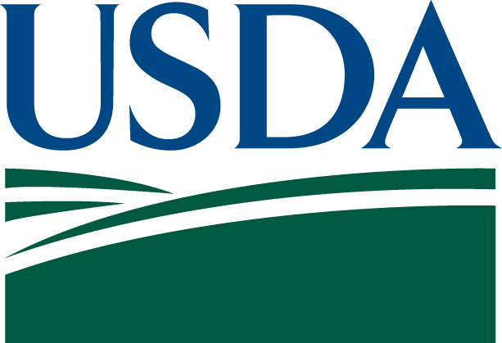
2023: THE YEAR OF OPEN SCIENCE
https://open.science.gov
Notes:
USDA is participating in this.
Public Access is only one part of open science, but it is a cornerstone of our efforts so watch this website as we announce new developments and activities.

Slide 12
How you can help
When plan is released, provide a written report with your feedback.
Help plan and promote and participate in stakeholder engagements as part of the DR revision process.
Help us ensure that implementation of these policies promotes equity for research community and our stakeholders.
Rich.Derksen@usda.gov
Paul.Wester@usda.gov
Cynthia.Parr@usda.gov
Notes:
We have a plan, we next will be developing formal policies, and the devil can be in the details of implementation.
You can help right now by asking any questions that you have or raise any concerns about this rapidly changing landscape.
What does all this mean for you and your stakeholder communities?
How can we better hear from all of our stakeholders? We’re getting lots of contacts from the publishing industry, because the removal of the embargoes has consequences for them, but we want to hear from everyone.
How do we strike a balance between flexibility and consistency as we implement these policies?

